Slide 1

Year-in-Review 2012
A recap of events that shaped Compliance
Click to Start
JANUARY 29, 2013

Slide 2

The compliance landscape continues to see change.
Important change.
Change that affects us all.

Slide 3
Healthcare Reform (including Sunshine Act) is here to stay.
Supreme Court upholds PPACA in 5-4 decision…

Slide 4
…yet Sunshine Act regulations remain with White House Office of Management & Budget (OMB).

Slide 5
The fight against foreign corruption gains clarity,
The DOJ and SEC release
FCPA Resource Guide.

Slide 6
while off-label prosecution gains complexity.
US Court of Appeals overturns
rep conviction in Caronia decision.

Slide 7
This year marked the highest total for federal settlements:
$6.4 billion in 2012
versus $1.5 billion in 2011
including largest and third-largest settlements ever (GSK’s $3 billion, Abbott’s $1.5 billion)…

Slide 8

Federal Settlements
2012
JANUARY
$118.6 million for drug-pricing allegations
JANUARY
FEBRUARY
MARCH
APRIL
MAY
JUNE
JULY
AUGUST
SEPTEMBER
OCTOBER
NOVEMBER
DECEMBER

Slide 9

Federal Settlements
2012
JANUARY
FEBRUARY
$11 million to settle False Claims Act allegations
FEBRUARY
MARCH
APRIL
MAY
JUNE
JULY
AUGUST
SEPTEMBER
OCTOBER
NOVEMBER
DECEMBER

Slide 10

Federal Settlements
2012
JANUARY
FEBRUARY
$16.8 million to resolve FCPA investigation
FEBRUARY
MARCH
APRIL
MAY
JUNE
JULY
AUGUST
SEPTEMBER
OCTOBER
NOVEMBER
DECEMBER

Slide 11

Federal Settlements
2012
JANUARY
FEBRUARY
MARCH
$17.2 million to resolve FCPA allegations
MARCH
APRIL
MAY
JUNE
JULY
AUGUST
SEPTEMBER
OCTOBER
NOVEMBER
DECEMBER

Slide 12

Federal Settlements
2012
JANUARY
FEBRUARY
MARCH
$2.8 million to resolve alleged marketing of unapproved drugs
MARCH
APRIL
MAY
JUNE
JULY
AUGUST
SEPTEMBER
OCTOBER
NOVEMBER
DECEMBER

Slide 13

Federal Settlements
2012
JANUARY
FEBRUARY
MARCH
APRIL
$1.5 billion to resolve criminal and civil litigation of off-label promotion of Depakote
APRIL
MAY
JUNE
JULY
AUGUST
SEPTEMBER
OCTOBER
NOVEMBER
DECEMBER

Slide 14

Federal Settlements
2012
JANUARY
FEBRUARY
MARCH
APRIL
$190 million to resolve False Claims Act allegations
APRIL
MAY
JUNE
JULY
AUGUST
SEPTEMBER
OCTOBER
NOVEMBER
DECEMBER

Slide 15

Federal Settlements
2012
JANUARY
FEBRUARY
MARCH
APRIL
$322 million sentenced in connection with unlawful promotion of Vioxx
APRIL
MAY
JUNE
JULY
AUGUST
SEPTEMBER
OCTOBER
NOVEMBER
DECEMBER

Slide 16

Federal Settlements
2012
JANUARY
FEBRUARY
MARCH
APRIL
MAY
JUNE
$3 billion for off-label marketing, kickback allegations, and price reporting to Medicaid
JUNE
JULY
AUGUST
SEPTEMBER
OCTOBER
NOVEMBER
DECEMBER

Slide 17

Federal Settlements
2012
JANUARY
FEBRUARY
MARCH
APRIL
MAY
JUNE
$34 million to settle False Claim Act allegations
JUNE
JULY
AUGUST
SEPTEMBER
OCTOBER
NOVEMBER
DECEMBER

Slide 18
Federal Settlements
2012
JANUARY
$5.2 million to resolve FCPA allegations
JULY
JULY
FEBRUARY
AUGUST
MARCH
SEPTEMBER
APRIL
OCTOBER
MAY
NOVEMBER
JUNE
DECEMBER
JULY
AUGUST
SEPTEMBER
OCTOBER
NOVEMBER
DECEMBER

Slide 19

Federal Settlements
2012
JULY
AUGUST
$60 million to settle foreign bribery allegations
AUGUST
SEPTEMBER
OCTOBER
NOVEMBER
DECEMBER

Slide 20

Federal Settlements
2012
JULY
AUGUST
SEPTEMBER
OCTOBER
$95 million to resolve False Claims Act allegations
OCTOBER
NOVEMBER
DECEMBER

Slide 21

Federal Settlements
2012
JULY
AUGUST
SEPTEMBER
OCTOBER
NOVEMBER
$48 million to resolve False Claims Act allegations
DECEMBER
DECEMBER

Slide 22
Federal Settlements
2012
JULY
AUGUST
SEPTEMBER
OCTOBER
NOVEMBER
DECEMBER
$55 million for alleged off-label promotion of Protonix
DECEMBER

Slide 23

Federal Settlements
2012
JULY
AUGUST
SEPTEMBER
OCTOBER
NOVEMBER
DECEMBER
$109 million for False Claims Act allegations related to sampling arrangements
DECEMBER

Slide 24

Federal Settlements
2012
JULY
AUGUST
SEPTEMBER
OCTOBER
NOVEMBER
$762 million to resolve False Claims Act allegations
DECEMBER
DECEMBER

Slide 25

Federal Settlements
2012
JULY
AUGUST
SEPTEMBER
OCTOBER
NOVEMBER
DECEMBER
$11.4 million to resolve kickback allegations
DECEMBER

Slide 26

Federal Settlements
2012
JULY
AUGUST
SEPTEMBER
OCTOBER
NOVEMBER
DECEMBER
$29 million for alleged FCPA violations
DECEMBER

Slide 27


Federal Settlements Summary
2012
JANUARY
FEBRUARY
MARCH
APRIL
≈ $6.4 billion
MAY
JUNE
JULY
AUGUST
SEPTEMBER
OCTOBER
NOVEMBER
DECEMBER

Slide 28



State Settlements
JANUARY
$158 million agreement with Texas over Medicaid fraud allegations
FEBRUARY
$25.2 million settlement with Louisiana for fraud allegations
MARCH
$3.3 million agreement with Oregon for alleged deceptive marketing
APRIL
$1.1 billion penalty to Arkansas following Risperdal litigation
APRIL
$2.6 million to Idaho for false claim allegations
MAY
$1.5 billion drug settlement with Connecticut, Idaho, and 42 other states for off-label marketing of Depakote
$7 million settlement with Kentucky from AWP lawsuit
JUNE
$2.3 million settlement with Kentucky from AWP lawsuit

Slide 29





State Settlements
JULY
$1.7 million in drug pricing settlement
JULY
$151 million to settle drug-pricing lawsuit
AUGUST
$26 million to settle South Carolina lawsuit
$18.6 million to settle with Louisiana for alleged over-pricing
OCTOBER
OCTOBER
$1.9 million settlement to Colorado for Depakote allegations
OCTOBER
$90,000 to Maine for off-label marketing and kickbacks allegations
NOVEMBER
$90 million to states to resolve Avandia false claims allegations

Slide 30
State Updates

Slide 31
State Updates
MASSACHUSETTS
Repeals portion of gift ban, now allows modest meals outside of office

Slide 32
State Updates
VERMONT
Issued new guidelines; Allowed limited amnesty for device/biologic manufacturers that had failed to report

Slide 33
State Updates
DISTRICT OF COLUMBIA
Amended its Access Rx Act of 2004

Slide 34
State Updates
CALIFORNIA
& IOWA
Amended their False Claims Acts

Slide 35
When will the sun shine?

Slide 36
Sunshine Act Implementation Regulations
300+ entities submit comments on Proposed Rule (FEB)
Senators Kohl and Grassley urge CMS to issue final rule (MAR)
All 8 physician congressmen request changes to regulations (MAY)
CMS delays collection until after Jan 1, 2013. Announces internal work group and RFP to assist with final implementation (APR)
. . .

Slide 37
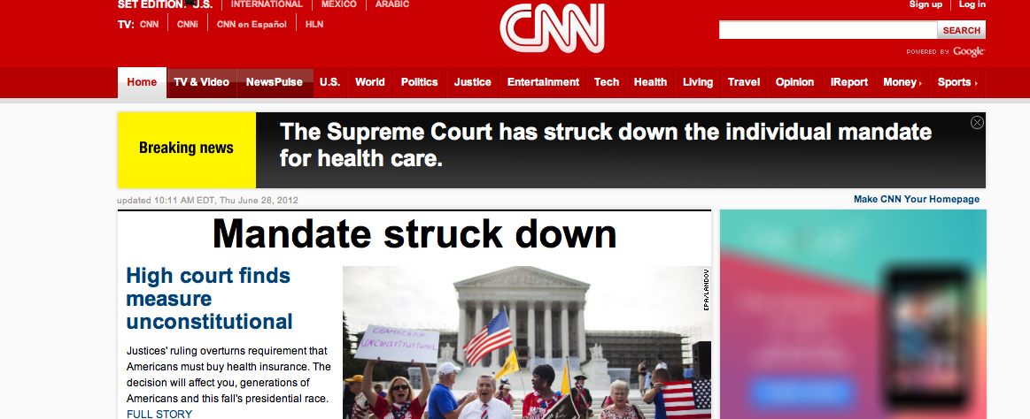
According to CNN & Fox News, PPACA is Unconstitutional…

Slide 38
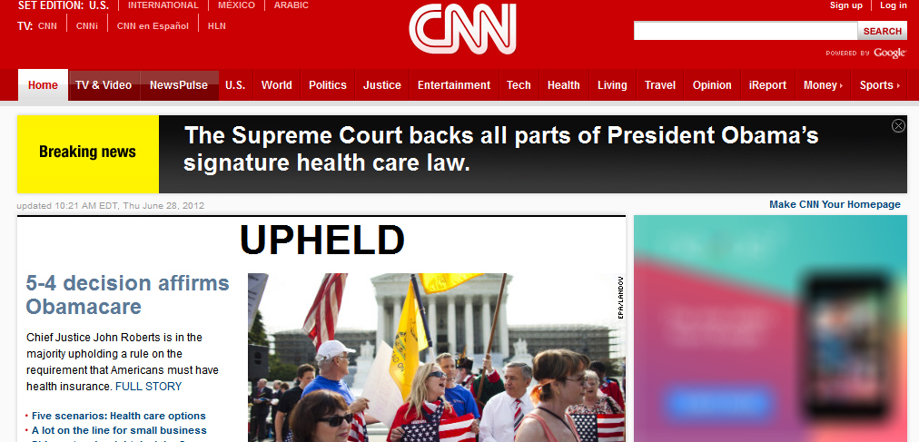
…for about 10 minutes.

Slide 39
Sunshine Act Implementation Regulations
300+ entities submit comments on Proposed Rule (FEB)
Sen Kohl and Grassley urge CMS to issue final rule on Doctor Payment Disclosure (MAR)
All 8 physician congressmen ask CMS for changes to proposed regulations (MAY)
CMS delays collection until after Jan 1, 2013. Announces internal work group and RFP to assist with final implementation (APR)
Supreme Court upholds PPACA (JUN)
Life science industry trade groups write CMS letter (AUG)
Kohl convenes roundtable on implementation of the Sunshine Act (SEPT)
Final regulations sent to OMB (NOV)

Slide 40
Government continues to prosecute individuals…
with mixed results.

Slide 41





Individual Responsibility
PRIOR ALLEGATIONS
Appeals court upholds HHS exclusion of former Purdue executives
NEW ALLEGATIONS
CEO of Globus Medical fined for unapproved devices
Former Vice-President of Orthofix convicted of violating Anti-Kickback Statute
SUCCESSFULLY DEFENDED ALLEGATIONS
US drops charges against former Stryker CEO, cites new evidence
US court voids former drug rep’s conviction, cites free speech

Slide 42
Regulations continue to evolve…

Slide 43
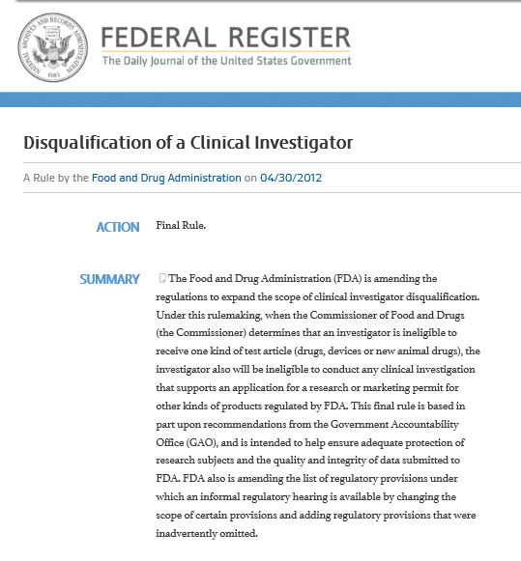
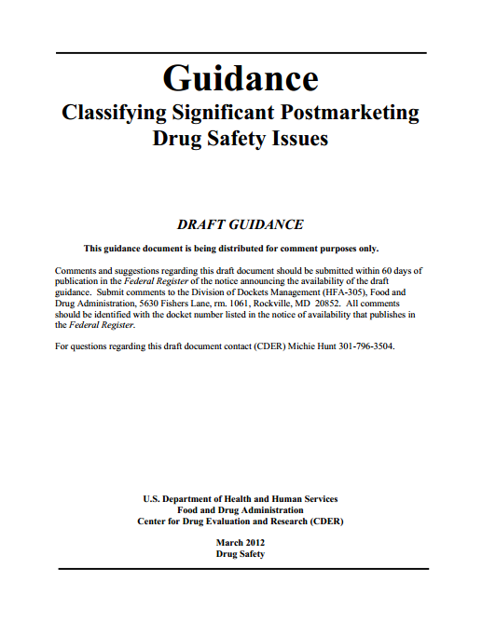

New Federal Guidance and Enforcement
FDA Draft Guidance
Classifying Significant Postmarket Drug Safety Issues
FDA Guidance
Product Name Placement, Size, and Prominence in Advertising and Promotional Labeling
DOJ FCPA Guide
A Resource for the U.S. Foreign Corrupt Practices Act
PhRMA
Principles on Interactions with Patient Organizations
FDA Draft Guidance
DTC Television Advertisements Pre-Dissemination Review Program
FDA Final Rule
Additional Restrictions on
Disqualified Clinical Investigators

Slide 44







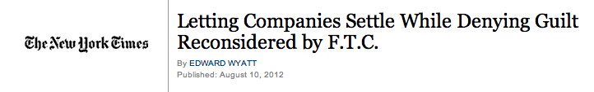



Other Key Compliance News

Slide 45

International Compliance
International Federation of Pharmaceutical Manufacturers and Associations (IFPMA) expands its Code of Practice to Govern Industry Interactions with HCPs
Ireland's Medical Council updates guidance for physician relationships with industry
UK’s Serious Fraud Office tightens self-reporting rules; Can criminally prosecute under Revised Bribery Act Guidance
New marketing code for Indian drug companies

Slide 46








International Compliance and Transparency
French Sunshine Act: Implementing decree expected in January; first disclosure potentially Summer 2013
UK / Japan / Slovakia disclosure likely required in 2013
Netherlands' Code of Conduct on Transparency of Financial Relations sets transparency threshold at €500
Australia capturing 2013 payments for disclosure in 2014
EFPIA requires disclosure of monetary value of support for Patient Organizations starting in 2013

Slide 47
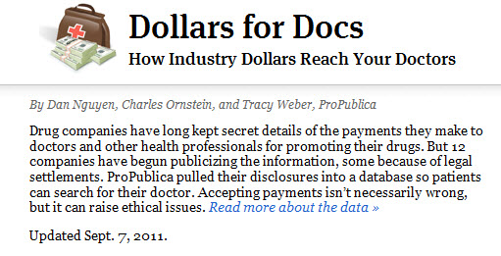
ProPublica Update
Dollars for Docs database last updated Sept. 7, 2011.
Not updated in 2012.
Has not kept up with larger data sets and broader reach

Slide 48
2013 is off to a fast start!
Pfizer and Endo settle with Texas for $36M.
Minnesota issues letter to Pharma >> No report required.
HHS releases long-awaited HIPAA/HITECH Final Regulations.
FDA issues Final Rule on cGMP Requirements for Combo Products.
Australia, Brazil, Canada and U.S. share med device audit program.
Amer. College of OB/GYN discourages promotional speakers.

Slide 49
Ready to keep pace with
the rest of 2013?

Slide 50
Sources
FEDERAL SETTLEMENTS
STATE SETTLEMENTS
http://www.businessweek.com/news/2012-01-06/actavis-will-pay-118-6-million-to-end-drug-pricing-claims.html
http://www.justice.gov/opa/pr/2012/February/12-civ-182.html
http://www.justice.gov/opa/pr/2012/February/12-crm-166.html
http://www.justice.gov/opa/pr/2012/March/12-crm-373.html
http://www.justice.gov/opa/pr/2012/March/12-civ-389.html
http://www.justice.gov/opa/pr/2012/March/12-civ-368.html
http://www.justice.gov/opa/pr/2012/May/12-civ-585.html
http://www.justice.gov/opa/pr/2012/April/12-civ-539.html
http://www.justice.gov/opa/pr/2012/April/12-civ-497.html
http://www.justice.gov/opa/pr/2012/July/12-civ-842.html
http://oig.hhs.gov/fraud/cia/agreements/GlaxoSmithKline_LLC_06282012.pdf
http://www.justice.gov/opa/pr/2012/June/12-civ-724.html
http://www.sec.gov/news/press/2012/2012-133.htm
http://www.justice.gov/opa/pr/2012/October/12-civ-1195.html
http://www.justice.gov/opa/pr/2012/October/12-civ-1291.html
https://oig.hhs.gov/fraud/cia/agreements/Boehringer_Ingelheim_Pharmaceuticals_10222012.pdf
http://freepdfhosting.com/fdead6cc8c.pdf
http://www.pharmalot.com/2012/11/lipitor-whistleblower-suit-against-pfizer-is-dismissed/
http://www.justice.gov/opa/pr/2012/December/12-civ-1459.html
http://www.justice.gov/opa/pr/2012/December/12-civ-1488.html
http://www.justice.gov/opa/pr/2012/December/12-civ-1526.html
http://www.justice.gov/opa/pr/2012/December/12-civ-1523.html
http://www.justice.gov/opa/pr/2012/December/12-civ-1547.html
https://www.oag.state.tx.us/oagNews/release.php?id=3956
http://www.ag.state.la.us/Article.aspx?articleID=558&catID=2
http://www.doj.state.or.us/releases/Pages/2012/rel032012.aspx
http://www.businessweek.com/news/2012-04-11/jnj-told-to-pay-1-dot-1-billion-penalty-in-arkansas-risperdal-trial
http://www.ag.idaho.gov/media/newsReleases/2012/nr_04172012.html
http://www.thelundreport.org/resource/oregon_department_of_justice_announces_100_million_consumer_protection_pharmaceutical_agree
http://www.boisestatepublicradio.org/post/idaho-other-northwest-states-net-millions-pharmaceutical-settlement
http://www.ctlawtribune.com/PubArticleCT.jsp?ID=42238&slreturn=1
http://migration.kentucky.gov/Newsroom/ag/johnsonawpsettlement.htm
http://migration.kentucky.gov/Newsroom/ag/Sanofiaventissettlement.htm
http://www.ag.idaho.gov/media/newsReleases/2012/nr_07162012.html
http://online.wsj.com/article/SB10000872396390444840104577553473340680142.html
http://ag.arkansas.gov/newsroom/index.php?do:newsDetail=1&news_id=571.html
http://uk.reuters.com/article/2012/08/24/uk-astrazeneca-settlement-idUKBRE87N11Q20120824
http://www.ag.state.la.us/Article.aspx?articleID=646&catID=2
http://www.coloradoattorneygeneral.gov/press/news/2012/10/05/attorney_general_announces_46_million_settlement_abbott_laboratories_over_drug
http://www.maine.gov/tools/whatsnew/index.php?topic=AGOffice_Press&id=449945&v=article10
http://www.justice.gov/opa/documents/gsk/plea-ex-c.pdf
http://www.bloomberg.com/news/2012-11-15/glaxo-pays-90-million-to-settle-states-avandia-claims.html

Slide 51
Sources
STATE UPDATES
SUNSHINE ACT IMPLEMENTATION REGULATIONS
Changes to Gift Ban (Sections 108-114): http://www.mass.gov/bb/gaa/fy2013/os_13/hdefault.htm
http://www.ama-assn.org/amednews/2012/07/23/prsb0723.htm
http://www.malegislature.gov/Budget/FY2013/House/WaysAndMeans
http://www.pharmalot.com/2012/04/massachusetts-house-votes-to-repeal-gift-ban-2/
http://www.atg.state.vt.us/assets/files/Official%20Notice%20Limited%20Offer%20of%20Amnesty%20for%20Failure%20to%20Report.pdf
http://www.marketingresearch.org/news/2012/09/06/vermont-attorney-general-office-offers-amnesty-for-failure-to-report
http://www.oig.hhs.gov/fraud/docs/falseclaimsact/Iowa.pdf
http://www.leginfo.ca.gov/pub/11-12/bill/asm/ab_2451-2500/ab_2492_bill_20120820_enrolled.html
http://www.jdsupra.com/legalnews/california-assembly-votes-to-amend-state-73757/
http://news.bostonherald.com/jobfind/news/healthcare/view/20221018medical_students_want_state_to_get_tougher_on_gifts_to_docs/srvc=home&position=also
http://www.phrma.org/sites/default/files/2101/phrma_comments_sunshine_comments_2_17_12.pdf
http://www.policymed.com/2012/03/physician-payment-sunshine-links-to-comments-to-cms.html
http://www.grassley.senate.gov/about/upload/2012_04_04-CEG-and-Kohl-to-CMS-Sunshine-Comments.pdf
http://blog.cms.gov/2012/05/03/information-on-implementation-of-the-physician-payments-sunshine-act/
http://www.grassley.senate.gov/about/upload/2012_05_03-CMS-to-CEG-Sunshine.pdf
http://policymed.typepad.com/files/doc-caucus-letter-to-cms-5-21-12.pdf
http://www.policymed.com/2012/05/physician-payment-sunshine-act-physician-congressman-ask-cms-for-changes-to-proposed-regulations.html
http://www.supremecourt.gov/opinions/11pdf/11-393c3a2.pdf
http://nbcpolitics.msnbc.msn.com/_news/2012/06/28/12457822-supreme-court-upholds-health-care-law?lite
http://aging.senate.gov/
http://www.bio.org/advocacy/letters/bio-comments-cms-physician-payments-sunshine-act
http://aging.senate.gov/hearing_detail.cfm?id=337621&
http://www.grassley.senate.gov/news/Article.cfm?customel_dataPageID_1502=42419
http://www.foxbusiness.com/news/2012/11/28/drug-device-makers-anxiously-await-us-doctor-payment-disclosure-rule/

Slide 52
Sources
INDIVIDUAL RESPONSIBILITY
NEW GUIDANCE
http://www.cadc.uscourts.gov/internet/opinions.nsf/459F3439969F140285257A48004F075C/$file/11-5028-1386058.pdf
http://www.reuters.com/article/2012/02/28/globus-fda-idUSL2E8DSFCD20120228
http://www.justice.gov/usao/ma/news/2012/April/GuerrieriThomasPleaPR.html
http://www.bloomberg.com/news/2012-02-02/stryker-official-s-charges-dropped-as-u-s-cites-new-evidence-in-drug-case.html
http://www.bloomberg.com/news/2012-01-12/stryker-biotech-bone-drug-marketing-put-patients-at-risk-prosecutor-says.html
http://www.reuters.com/article/2012/12/04/us-offlabel-conviction-idUSBRE8B21DC20121204?feedType=RSS&feedName=domesticNews
http://www.fda.gov/downloads/Drugs/GuidanceComplianceRegulatoryInformation/Guidances/UCM070076.pdf
http://www.fda.gov/downloads/Drugs/GuidanceComplianceRegulatoryInformation/Guidances/UCM295554.pdf
http://www.gpo.gov/fdsys/pkg/FR-2012-04-30/pdf/2012-10292.pdf
https://www.federalregister.gov/articles/2012/04/30/2012-10292/disqualification-of-a-clinical-investigator
http://phrma.org/sites/default/files/2392/phrma_principles_paper_20120919_final.pdf
https://s3.amazonaws.com/public-inspection.federalregister.gov/2012-23598.pdf
http://www.raps.org/focus-online/news/news-article-view/article/2299/fda-given-new-authority-to-oversee-clinical-trials-data-reporting.aspx
http://www.justice.gov/criminal/fraud/fcpa/guide.pdf

Slide 53
Sources
OTHER KEY COMPLIANCE EVENTS
INTERNATIONAL COMPLIANCE
http://oig.hhs.gov/compliance/compliance-guidance/docs/pharmaceutical-compliance-roundtable.pdf
http://www.ama-assn.org/amednews/2012/03/26/prl20326.htm
http://online.wsj.com/article/SB10001424052702303933404577505032006855076.html
http://www.pharmalot.com/2012/11/eisai-insurer-balks-at-paying-whistleblower-claim/
https://oig.hhs.gov/compliance/compliance-guidance/docs/Focus_on_Compliance.pdf
http://www.nytimes.com/2012/08/11/business/facebook-settlement-on-privacy-is-finalized-by-ftc.html?_r=3
http://www.ama-assn.org/amednews/2012/07/16/gvsb0716.htm
http://www.jsonline.com/features/health/doctors-with-links-to-drug-companies-influence-treatment-guidelines-ki7pjr6-184041791.html
http://www.ifpma.org/fileadmin/content/News/2012/FINAL_IFPMA_Press_Release_-_Code_of_Practice_1_March_2012.pdf
http://www.rte.ie/news/2012/1011/new-guidelines-for-doctors-and-pharma-industry.html
http://www.sfo.gov.uk/bribery--corruption/the-bribery-act/questions-and-answers.aspx
http://articles.economictimes.indiatimes.com/2012-07-18/news/32730829_1_pharmaceutical-market-indian-pharmaceutical-alliance-industry-bodies
http://in.reuters.com/article/2012/10/16/abbott-india-doctors-gifts-idINDEE89F0H820121016?rpc=401&feedType=RSS&feedName=businessNews&rpc=401
http://www.lexology.com/library/detail.aspx?g=4e848dcb-40ad-4fa1-ba30-9482da84a3a
http://www.sidley.com/files/Publication/22201a5a-9bcf-4936-b20d-c45ab300662e/Presentation/PublicationAttachment/7e590df9-8ab4-412d-8846-c6ef39695fca/Datta%20Law360.pdf
http://www.ehcca.com/presentations/intpharmacon6/vanblokland_2_h1.pdf
http://medicinesaustralia.com.au/code-of-conduct/code-of-conduct-current-edition/
http://www.efpia.eu/sites/www.efpia.eu/files/PO_Code_-_SGA_14_June_2011-20110627-004-EN-v1_0.pdf
http://www.abpi.org.uk/our-work/library/guidelines/Pages/code-2012.aspx
INTERNATIONAL TRANSPARENCY
JANUARY 2013 UPDATES
https://www.oag.state.tx.us/oagnews/release.php?id=4262
http://www.pharmaspective.com/2013/01/the-minnesota-board-of-pharmacy-will-not-require-the-submission-of-annual-disclosure-reports-for-the.html
http://ofr.gov/OFRUpload/OFRData/2013-01073_PI.pdf
http://www.gpo.gov/fdsys/pkg/FR-2013-01-22/html/2013-01068.htm
http://www.massdevice.com/news/australia-brazil-canada-and-us-plan-shared-medical-device-audit-program
http://www.acog.org/~/media/Committee%20Opinions/Committee%20on%20Ethics/co541.pdf?dmc=1&ts=20121025T1645228769.

Slide 54
Thank you.
Call us at 703.430.5944,
or visit www.potomacriverpartners.com

