Slide 1
Year-in-Review 2011
A look back at events that helped shape Compliance

Slide 2
Important Compliance Releases
DECEMBER 2011
CMS finally releases Sunshine Act draft regulations
Drug makers get more time to record payments to doctors

Slide 3
Important Compliance Releases
DECEMBER 2011
FDA releases draft guidance for off-label inquiries
Responses to unsolicited off-label questions must be in private

Slide 4
Federal Settlements

Slide 5
Federal Settlements Summary
Federal settlements continue to affect our industry. While total settlements of ≈$1.5B are lower this year, over ≈$5B in pending settlements have been announced:
$3B for criminal and civil claims, including Avandia investigation (PENDING)
$1.3B for alleged illegal marketing of Depakote (PENDING)
$780M for alleged improper sales of drugs (PENDING)

Slide 6
Federal Settlements
JAN 2011
$296M to settle failure to report allegations

Slide 7
Federal Settlements
FEB 2011
$170M to settle Medicaid pricing fraud allegations

Slide 8
Federal Settlements
APR 2011
$70M to settle FCPA allegations

Slide 9
Federal Settlements
JUN 2011
$34M to settle off-label marketing allegations

Slide 10
Federal Settlements
JUN 2011
$26.7M to settle off-label marketing allegations

Slide 11
Federal Settlements
SEP 2011
$79M to settle drug-pricing allegations

Slide 12
Federal Settlements
SEP 2011
$66M to settle drug-pricing allegations

Slide 13
Federal Settlements
SEP 2011
$85M Pleads guilty to marketing violations

Slide 14
Federal Settlements
SEP 2011
$9.25M to settle False Claims Act allegations

Slide 15
Federal Settlements
OCT 2011
$14.5M to settle illegal marketing allegations

Slide 16
Federal Settlements
OCT 2011
$2.3M to settle physician anti-kickback allegations

Slide 17
Federal Settlements
NOV 2011
$950M to settle illegal marketing allegations

Slide 18
Federal Settlements
NOV 2011
$60M to settle FCPA allegations

Slide 19
Federal Settlements
DEC 2011
$17M to settle False Claims Act allegations

Slide 20
Federal Settlements
DEC 2011
$23.5M to settle U.S. probe over doctor kickback allegations

Slide 21
Federal Settlements 2011 Summary
JAN
FEB
APR
JUN
SEP
OCT
NOV
DEC

Slide 22
State Settlements

Slide 23
State Settlements
MAR 2011
$68.5M to 37 states and DC to settle off-label promotion allegations

Slide 24
State Settlements
APR 2011
$153M to Alaska, South Carolina, and Kentucky to settle pricing allegations

Slide 25
State Settlements
JUN 2011
$327M to South Carolina to settle deceptive marketing allegations

Slide 26
State Settlements
JUN 2011
$40.75M to 37 states and DC for drug manufacturing standards allegations

Slide 27
State Settlements
SEP 2011
$188.2M to California, Florida, and Mississippi for pricing allegations

Slide 28
State Settlements
DEC 2011
$24M to Massachusetts to settle fraud allegations

Slide 29
State Settlements
DEC 2011
$84M to Texas to settle drug-pricing allegations

Slide 30
State Settlements 2011 Summary
MAR
APR
JUN
SEP
DEC

Slide 31
State Law Updates

Slide 32
State Updates
2011: An easing of state requirements

Slide 33
State Updates
VERMONT
Data mining law overturned by Supreme Court (JUN 2011)

Slide 34
State Updates
MAINE
State repeals three ‘Get Tough on Pharma’ Laws (JUL 2011)

Slide 35
State Updates
WEST VIRGINIA
Governor withdraws Pharmaceutical Disclosure Rules
(NOV 2011)

Slide 36
New Federal Guidance and Enforcement
FDA publishes criteria for Park Doctrine prosecutions (FEB 2011)
Justice Department rules certain paid trips don’t violate FCPA (JUL 2011)
FDA releases guidance for mobile medical apps (JUL 2011)
FDA issues draft guidance on clinical trial investigators (AUG 2011)
FDA issues revised guidance on unapproved drugs (SEPT 2011)
FDA releases proposals increasing transparency to agency’s data (SEPT 2011)
Pending release—Department of Justice announces they will release Foreign Corrupt Practices Act guidance in 2012 (NOV 2011)

Slide 37
Individual Responsibility*
PRIOR ALLEGATIONS:
APR 2011
Ex-CEO of InterMune sentenced in fraud case
SEPT 2011
Government files brief in Purdue executives’ exclusion litigation
NOV/DEC 2011
Former Synthes executives sentenced to prison in unlawful clinical trials case
*Company logos are used for illustrative purposes only—individual prosecution does not implicate corporate responsibility

Slide 38
Individual Responsibility*
NEW ALLEGATIONS:
SEPT 2011
Founder of Servier under investigation by French judges
DEC 2011
Former Siemens executives charged with bribery
SUCCESSFULLY DEFENDED ALLEGATIONS:
MAY 2011
Judge tosses charges against ex-GSK lawyer
AUG 2011
U.S. drops case against Forest CEO
*Company logos are used for illustrative purposes only—individual prosecution does not implicate corporate responsibility

Slide 39
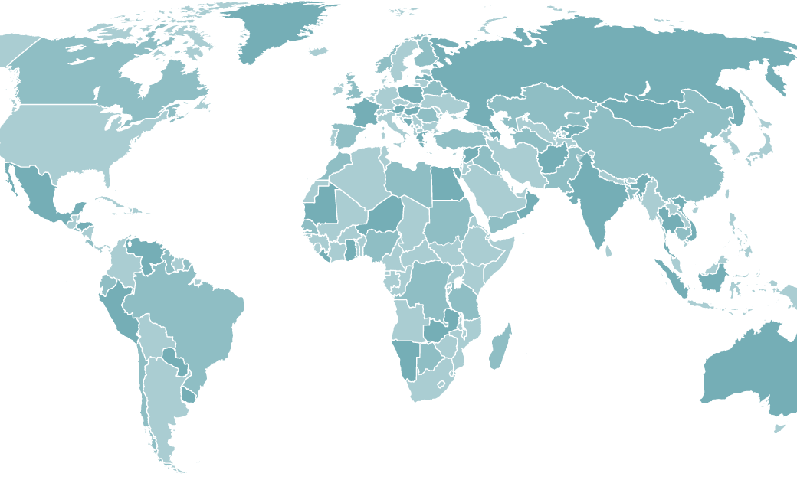
International Compliance
JUL 2011
UK Bribery Act becomes effective
JUL 2011
France’s new regulation will strengthen pharmacovigilance, create greater transparency
SEPT 2011
EFPIA backs move towards full clinical data transparency
OCT 2011
EU sets out tough rules on communicating medicines information to patients
OCT 2011
Netherlands government fines Allergan for paying HCPs to attend an “information afternoon”
NOV 2011
AstraZeneca indicted in Serbian corruption case
NOV 2011
Chinese drug official given suspended death sentence
DEC 2011
Scandal over Mediator, a French weight-loss drug, prompts calls
for wide changes

Slide 40
Other Key Events
AstraZeneca—No more free trips for doctors (MAY 2011)
Harvard docs punished for undisclosed pharma ties (JUL 2011)
Aurora bans doctors from giving free drug samples (JUL 2011)
DDMAC reorganized into Office of Prescription Drug Promotion (SEPT 2011)
Justice Department asks the Supreme Court to review the Affordable Care Act (SEPT 2011)
Medicare administrator Donald Berwick resigns in the face of Republican opposition (NOV 2011)

Slide 41
ProPublica in the News

Slide 42
‘11
2012
2011
Lower federal settlements than 2010
Continued regulatory change
Sunshine Act draft regulations
New guidance on unsolicited inquiries
‘12
Expect a new wave of enforcement and regulation

Slide 43
Sources
IMPORTANT COMPLIANCE RELEASES
FEDERAL SETTLEMENTS
https://s3.amazonaws.com/public-inspection.federalregister.gov/2011-32244.pdf
http://www.cms.gov/apps/media/press/release.asp?Counter=4220&intNumPerPage=10&checkDate=&checkKey=&srchType=1&numDays=3500&srchOpt=0&srchData=&keywordType=All&chkNewsType=1%2C+2%2C+3%2C+4%2C+5&intPage=&showAll=&pYear=&year=&desc=&cboOrder=date
http://www.reuters.com/article/2011/12/15/us-cms-sunshine-idUSTRE7BE04N20111215
http://www.fda.gov/downloads/Drugs/GuidanceComplianceRegulatoryInformation/Guidances/UCM285145.pdf
http://www.justice.gov/opa/pr/2011/January/11-civ-035.html
http://www.justice.gov/opa/pr/2011/April/11-crm-446.html
http://www.justice.gov/opa/pr/2011/June/11-civ-751.html
http://www.justice.gov/opa/pr/2011/June/11-civ-764.html
http://www.bloomberg.com/news/2011-09-14/watson-pharmaceuticals-will-pay-79-million-to-settle-lawsuit.html
http://www.reuters.com/article/2011/09/14/us-johnsonjohnson-natrecor-idUSTRE78D7CY20110914
http://www.justice.gov/opa/pr/2011/September/11-civ-1256.html
http://www.justice.gov/opa/pr/2011/October/11-civ-1389.html
http://www.justice.gov/opa/pr/2011/October/11-civ-1409.html
http://www.foxbusiness.com/markets/2011/11/03/glaxo-settles-us-drug-dispute-for-3b/
http://www.bloomberg.com/news/2011-10-24/amgen-says-it-set-aside-780-million-to-settle-drug-sale-kickback-claims.html
http://www.bloomberg.com/news/2011-10-21/abbott-said-to-agree-to-pay-1-3-billion-to-end-depakote-suits.html
http://www.justice.gov/opa/pr/2011/November/11-civ-1524.html
http://www.reuters.com/article/2011/11/21/pfizer-idUSN1E7AJ0CG20111121
http://www.justice.gov/opa/pr/2011/December/11-civ-1579.html
http://www.justice.gov/opa/pr/2011/December/11-civ-1623.html
STATE SETTLEMENTS
http://www.latimes.com/business/la-fi-0311-astrazeneca-settlement-20110311,0,4119624.story
http://www.reuters.com/article/2011/04/27/parpharma-idUSL3E7FR53G20110427
http://www.bloomberg.com/news/2011-06-03/j-j-ordered-to-pay-327-million-on-deceptive-marketing-claims.html
http://www.goupstate.com/article/20111221/articles/111229952?p=1&tc=pg
http://illinoisattorneygeneral.gov/pressroom/2011_06/20110623.html
http://www.ago.state.ms.us/index.php/press/releases/ag_wins_382_million_verdict_for_the_state_of_mississippi_in_medicaid_fraud_/
http://freepdfhosting.com/0885cf397f.pdf
http://www.mass.gov/ago/news-and-updates/press-releases/2011/2011-12-20-merk-lawsuit.html
https://www.oag.state.tx.us/oagnews/release.php?id=3949

Slide 44
Sources
NEW FEDERAL GUIDANCE AND ENFORCMENT
STATE UPDATES
http://www.justice.gov/criminal/fraud/fcpa/opinion/2011/11-01.pdf
http://www.fda.gov/downloads/MedicalDevices/DeviceRegulationandGuidance/GuidanceDocuments/UCM263366.pdf
http://www.fda.gov/downloads/drugs/guidancecomplianceregulatoryinformation/guidances/ucm269919.pdf
http://www.fda.gov/Drugs/GuidanceComplianceRegulatoryInformation/EnforcementActivitiesbyFDA/SelectedEnforcementActionsonUnapprovedDrugs/ucm270831.htm
http://www.fda.gov/downloads/AboutFDA/Transparency/TransparencyInitiative/UCM273145.pdf
http://www.justice.gov/criminal/pr/speeches/2011/crm-speech-111108.html
http://www.boston.com/news/health/blog/2011/04/house_votes_to.html
http://www.wwlp.com/dpp/news/politics/state_politics/drug-coupon-bill-supporters-protest-ban
http://www.supremecourt.gov/opinions/10pdf/10-779.pdf
http://www.mainelegislature.org/legis/bills/bills_125th/chappdfs/PUBLIC461.pdf
http://www.wvgazette.com/News/201111070210
INTERNATIONAL COMPLIANCE
http://www.guardian.co.uk/law/2011/jul/15/bribery-act-phone-hacking-investigation
http://www.inpharm.com/news/162390/france-cleans-regulation-and-restricts-pharma-role
http://www.pharmatimes.com/Article/11-09-06/EFPIA_backs_move_towards_full_clinical_data_transparency.aspx
http://www.reuters.com/article/2011/10/11/us-europe-medicines-idUSTRE79A2P020111011
http://www.dutchnews.nl/news/archives/2011/10/drugs_company_fined_for_paying.php
http://www.ft.com/cms/s/0/d3589da8-0073-11e1-930b-00144feabdc0.html#axzz1fqvd3zGQ
http://www.boston.com/business/articles/2011/11/09/chinese_drug_exec_given_suspended_death_sentence/
http://www.nytimes.com/2011/12/12/health/scandal-widens-over-french-weight-loss-drug-mediator.html?_r=3
INDIVIDUAL RESPONSIBILITY
http://www.justice.gov/opa/pr/2011/April/11-civ-475.html
http://uk.reuters.com/article/2011/05/10/glaxosmithkline-lawyer-idUKN1010732620110510?rpc=401&feedType=RSS&feedName=governmentFilingsNews
http://www.reuters.com/article/2011/08/05/forest-idUSN1E7740UF20110805
http://www.hpm.com/pdf/blog/FriedmanvSebelius-DOJBr.pdf
http://www.reuters.com/article/2011/09/21/france-drug-idUSL5E7KL6XP20110921
http://www.justice.gov/usao/pae/News/2011/Nov/synthesexecs_release.pdf
http://www.justice.gov/opa/pr/2011/December/11-crm-1626.html

Slide 45
Sources
PROPUBLICA IN THE NEWS
http://www.propublica.org/article/piercing-the-veil-more-drug-companies-reveal-payments-to-doctors
http://www.tulsaworld.com/news/article.aspx?subjectid=17&articleid=20111024_17_A1_CUTLIN143530
http://www.texastribune.org/texas-state-agencies/department-of-state-health-services/state-employed-doctors-also-paid-drug-companies/?utm_source=texastribune.org&utm_medium=rss&utm_campaign=Tribune%20Feed:%20Emily%20Ramshaw
http://jacksonville.com/opinion/editorials/2011-12-11/story/does-your-doctor-get-payola-prescriptions
http://www.bizjournals.com/houston/news/2011/11/25/houston-doctors-received-large-drug.html
http://www.wtol.com/story/15895278/dollars-for-docs-northwest-ohio-docs-makind-big-money-from-big-drug-companies
http://www.northcoastjournal.com/news/2011/09/15/dollars-docs/3/
http://www.wtol.com/story/15929502/dollars-for-docs-a-toledo-doctor-speaks-out
http://roswell.11alive.com/news/news/88061-dollars-docs-doctors-receive-money-drug-companies
http://www.theavtimes.com/2011/12/06/local-doctors-accept-thousands-in-drug-company-dollars/
http://www2.timesdispatch.com/lifestyles/2011/jan/02/tdmain01-payments-to-doctors-from-drug-companies-s-ar-747608/
http://www.wtsp.com/news/article/208429/34/Dollars-for-Docs-doctors-receive-money-from-drug-companies
http://coloradoindependent.com/72289/u-c-denver-looking-to-rewrite-rules-for-docs-taking-drug-company-money
http://www.newsreview.com/chico/drug-company-dollars-for-local-docs/content?oid=4026942
http://www.timesnews.net/article/9035619/drug-firms-defend-39interactions39-with-doctors-propublica-adds-to-database-that-includes-almost-700000-to-tri-cities-physicians
http://www.npr.org/2011/09/13/140438636/doctors-often-receive-payments-from-drug-companies
http://www.huffingtonpost.com/propublica/patients-deserve-to-know_b_955539.html
http://www.usatoday.com/money/industries/health/2011-05-05-medical-societies-sell-access-to-manufacturers_n.htm
http://articles.sfgate.com/2011-05-20/news/30222248_1_policies-drug-companies-teaching-hospitals
http://josephsoninstitute.org/business/blog/2011/09/shining-a-light-on-unethical-relationships-between-doctors-and-drug-companies/
http://www.stltoday.com/lifestyles/health-med-fit/fitness/article_5921d9fd-71e8-5527-b8ad-b96684fc345f.html
http://m.mailtribune.com/apps/pbcs.dll/article?AID=%2F20110925%2FNEWS%2F109250316&template=wapart
http://www.forbes.com/sites/richardlevick/2011/09/14/naming-names-lawmakers-tighten-the-screws-on-pharmaceutical-marketing/
http://www.cbsnews.com/8301-500188_162-20124165/mega-bucks-flow-from-drug-cos-to-doctors/

Slide 46
Sources
OTHER KEY EVENTS
http://www.reuters.com/article/2011/05/27/astrazeneca-junkets-idUSLDE74P1YI20110527
http://www.thecrimson.com/article/2011/7/2/school-medical-harvard-investigation/
http://www.jsonline.com/business/126069288.html
http://www.cohealthcom.org/2011/09/19/ddmac-reorganized-into-office-of-prescription-drug-promotion/
http://www.justice.gov/healthcare/docs/hhs-v-florida-petition-certiorari.pdf
http://www.fda.gov/downloads/Drugs/GuidanceComplianceRegulatoryInformation/EnforcementActivitiesbyFDA/WarningLettersandNoticeofViolationLetterstoPharmaceuticalCompanies/UCM270607.pdf
http://www.mmm-online.com/lipitorcom-gets-bad-ad-slap-for-cross-promotion-sans-risk-info/article/211332/
http://www.washingtonpost.com/national/health-science/medicare-administrator-donald-berwick-resigns-in-the-face-of-republican-opposition/2011/11/23/gIQA5S7mpN_story.html

Slide 47
Thank you.
Potomac River Partners
A specialized management consulting firm focused on healthcare compliance.
For more information, call 703-430-5944 or visit www.potomacriverpartners.com

