Slide 1
YEAR-IN-REVIEW 2016
by POTOMAC RIVER PARTNERS
START >
Year-in-Review 2016
www.potomacriverpartners.com

Slide 2
2016 was highlighted by….
increased US Government scrutiny
Year-in-Review 2016
www.potomacriverpartners.com

Slide 3
of Foreign Conduct:
6 FCPA settlements covering conduct in China, Russia, Ukraine, and Mexico
Year-in-Review 2016
www.potomacriverpartners.com

Slide 4
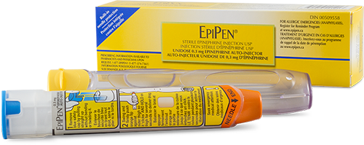
of Pricing:
Congress questions Mylan CEO over EpiPen price hikes amidst wide-spread public outrage
Year-in-Review 2016
www.potomacriverpartners.com

Slide 5
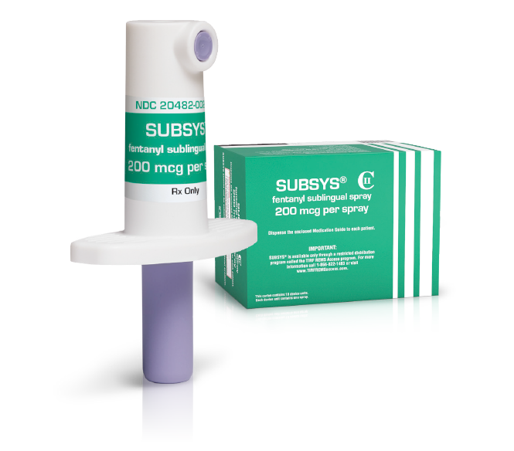
of Opioids:
10 former Insys employees arrested in kickback scheme surrounding Subsys
Year-in-Review 2016
www.potomacriverpartners.com

Slide 6
U.S. FEDERAL SETTLEMENTS
Year-in-Review 2016
www.potomacriverpartners.com

Slide 7
2016
U.S. FEDERAL SETTLEMENTS
FEBRUARY
$623.2 million to settle kickback allegations
$784.6 million to resolve Medicaid reimbursement allegations
$12 million to settle Foreign Corrupt Practices Act (FCPA) allegations
FCA / Kickback
FCPA
Other

Slide 8
2016
U.S. FEDERAL SETTLEMENTS
MARCH
$34.7 million to resolve False Claims Act (FCA) allegations
$34.8 million to settle kickback and FCA allegations
$25 million to settle FCPA allegations
FCA / Kickback
FCPA
Other

Slide 9
2016
U.S. FEDERAL SETTLEMENTS
APRIL
$4 million to settle
SEC allegations of incomplete disclosures
FCA / Kickback
FCPA
Other

Slide 10
2016
U.S. FEDERAL SETTLEMENTS
MAY
$67 million to settle FCA allegations
$55 million to settle SEC allegations of incomplete disclosures
$40 million to settle FCA allegations
FCA / Kickback
FCPA
Other

Slide 11
2016
U.S. FEDERAL SETTLEMENTS
JUNE
$14 million to resolve FCPA allegations
$54 million to settle kickback allegations
FCA / Kickback
FCPA
Other

Slide 12
2016
U.S. FEDERAL SETTLEMENTS
JULY
$8 million to settle kickback and FCA allegations
J&J (subsidiary Acclarent) pays $18 million to settle False Claims Act allegations
$18 million to settle FCA allegations
$7.6 million to settle export trade allegations
FCA / Kickback
FCPA
Other

Slide 13
2016
U.S. FEDERAL SETTLEMENTS
AUGUST
$5.5 million to settle FCPA allegations
FCA / Kickback
FCPA
Other

Slide 14
2016
U.S. FEDERAL SETTLEMENTS
SEPTEMBER
$20 million to settle FCPA allegations
FCA / Kickback
FCPA
Other

Slide 15
2016
U.S. FEDERAL SETTLEMENTS
OCTOBER
$28 million to settle kickback allegations
FCA / Kickback
FCPA
Other

Slide 16
2016
U.S. FEDERAL SETTLEMENTS
DECEMBER
$519 million to resolve FCPA allegations
$38 million to resolve FCA allegations
FCA / Kickback
FCPA
Other

Slide 17
TOTAL =
20 COMPANIES
$2.39 BILLION
FCA / Kickback
FCPA
Other

Slide 18
STATE SETTLEMENTS
Year-in-Review 2016
www.potomacriverpartners.com

Slide 19
Kentucky:
Purdue Pharma paid $24 million for OxyContin promotion
Kentucky & South Carolina:
J&J paid $139.5 million to settle False Claims Act allegations in Risperdal cases
New York:
Cephalon (now part of Teva) paid $125 million to settle anticompetitive conduct allegations
California:
BMS paid $30 million to settle kickback and False Claims Act allegations
42 States + Washington, D.C.:
BMS paid $19.5 million to settle off-label promotion allegations
Year-in-Review 2016
www.potomacriverpartners.com

Slide 20
CIVIL LITIGATION
Year-in-Review 2016
www.potomacriverpartners.com

Slide 21
$830 million to settle Vioxx complaints
Year-in-Review 2016
www.potomacriverpartners.com

Slide 22
$70 million in Risperdal side effects case
$120 million to settle thousands of trans-vaginal mesh lawsuits
$800 million to settle allegations of hiding antibiotic Levaquin’s side effects
~ $1.1 billion to settle lawsuits surrounding defective Pinnacle hip implant
$195 million in damages for failure to disclose link between cancer and its talc-based products
Year-in-Review 2016
www.potomacriverpartners.com

Slide 23
But…
Year-in-Review 2016
www.potomacriverpartners.com

Slide 24
Appellate court overturned $18 million fine against Roche
Year-in-Review 2016
www.potomacriverpartners.com

Slide 25
Appellate court absolved AstraZeneca and Ranbaxy in
pay-for-delay case
Year-in-Review 2016
www.potomacriverpartners.com

Slide 26
Jury cleared Abbott in
$1 billion FCA trial
Year-in-Review 2016
www.potomacriverpartners.com

Slide 27
Judge exonerated Pfizer
in birth defect cases
Year-in-Review 2016
www.potomacriverpartners.com

Slide 28
STATE & LOCAL LAW UPDATES
Year-in-Review 2016
www.potomacriverpartners.com

Slide 29
Vermont
House approved pricing transparency bill
Connecticut
Implemented APRN disclosure bill
Chicago
Requires sales reps to obtain license
California, Connecticut, Idaho, Maine, West Virginia
Passed right-to-try bills
Washington D.C.
Clarified scope for licensing and mirrored Open Payments report
Year-in-Review 2016
www.potomacriverpartners.com

Slide 30
INDIVIDUAL RESPONSIBILITY
Year-in-Review 2016
www.potomacriverpartners.com

Slide 31
3 former Insys employees plead guilty in kickback scheme; 7 others indicted
Year-in-Review 2016
www.potomacriverpartners.com

Slide 32
Theranos founder,
Elizabeth Holmes, barred from running labs for 2 years
Year-in-Review 2016
www.potomacriverpartners.com

Slide 33
Former Valeant and Philidor execs charged in fraud and kickback scheme
Year-in-Review 2016
www.potomacriverpartners.com

Slide 34
Warner Chilcott exec acquitted on kickback scheme
Former Warner Chilcott sales exec sentenced to probation and $10K fine for HIPAA violations
Year-in-Review 2016
www.potomacriverpartners.com

Slide 35
Vascular Solutions CEO acquitted on ten felony charges related to off-label promotion
Year-in-Review 2016
www.potomacriverpartners.com

Slide 36
Former Acclarent CEO and VP of Sales acquitted on 14 felony charges related to improper marketing
Year-in-Review 2016
www.potomacriverpartners.com

Slide 37
NEW FEDERAL LAW
Year-in-Review 2016
www.potomacriverpartners.com

Slide 38
President Obama signed 21st Century Cures Act
Year-in-Review 2016
www.potomacriverpartners.com

Slide 39
PRICING
Year-in-Review 2016
www.potomacriverpartners.com

Slide 40
Headlining 2016 was…
for price increase of EpiPen
Year-in-Review 2016
www.potomacriverpartners.com

Slide 41
Senate,
unsatisfied with settlement,
called for DOJ
to reopen its investigation
Over 400%
increase from
2008-2016
Settled with
DOJ for
$465 million
Year-in-Review 2016
www.potomacriverpartners.com

Slide 42
Plus…
Year-in-Review 2016
www.potomacriverpartners.com

Slide 43
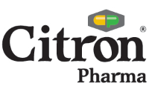
Congress called for Medivation to lower price of Xtandi
DOJ subpoenaed Taro Pharma execs over generics pricing
Congress investigated Ariad Pharmaceuticals for ‘staggering’ price hikes
20 States accused six pharmaceutical companies of price fixing
PRICING
Year-in-Review 2016
www.potomacriverpartners.com

Slide 44
The industry responds…
Year-in-Review 2016
www.potomacriverpartners.com

Slide 45
Eli Lilly partnered with Express Scripts to provide discounts on insulin products
Allergan
agreed to cap price increases
Novo Nordisk agreed to cap price increases on insulin products
Allergan
agreed to cap price increases
Novo Nordisk agreed to cap price increases on insulin products
Year-in-Review 2016
www.potomacriverpartners.com

Slide 46
The “Opioid Crisis” was frequently in the press…
Year-in-Review 2016
www.potomacriverpartners.com

Slide 47
The opioid crisis in Rhode Island
Tennessee parents lose kids as opioid crisis rages on
John Oliver takes on America’s Opioid Crisis
How drug companies helped drive the opioid crisis
The VA hooked veterans on opioids, then failed them again
Wave of opioid-related deaths hits Erie County
Southeast Texas far from immune to opioid epidemic continuing to sweep across the nation
Opioid epidemic leads to foster care crisis in many states
Opioid-related crimes continued to climb in 2016
Fentanyl outpaces heroin as the deadliest drug on Long Island
Drug industry hired dozens of officials from the DEA as the agency tried to curb opioid abuse
South Florida’s opioid overdose crisis: at least 800 expected to die by end of 2016
Hacking a solution to Boston’s Opioid Crisis
Year-in-Review 2016
www.potomacriverpartners.com

Slide 48
The government responds:
West Virginia agrees to $4.2 million settlement with 5 drug wholesalers for shipping excessive numbers of opioids
10 employees arrested in connection with Subsys kickbacks
New York agrees to $200 thousand settlement with Endo for improper opioid marketing
Chicago will license pharma sales reps to fight opioid overprescribing
Illinois AG sues Insys for deceptive opioid marketing
Year-in-Review 2016
www.potomacriverpartners.com

Slide 49
PATIENT ASSISTANCE PROGRAM SCRUTINY
Year-in-Review 2016
www.potomacriverpartners.com

Slide 50
Gilead, Biogen, Jazz, and Celgene questioned on relationships with independent charities
Year-in-Review 2016
www.potomacriverpartners.com

Slide 51
NEW FDA GUIDANCES
Year-in-Review 2016
www.potomacriverpartners.com

Slide 52
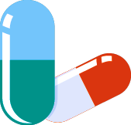
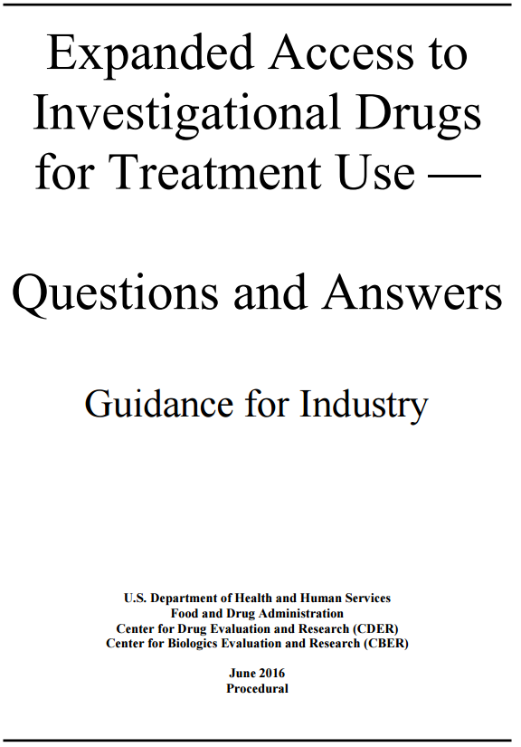
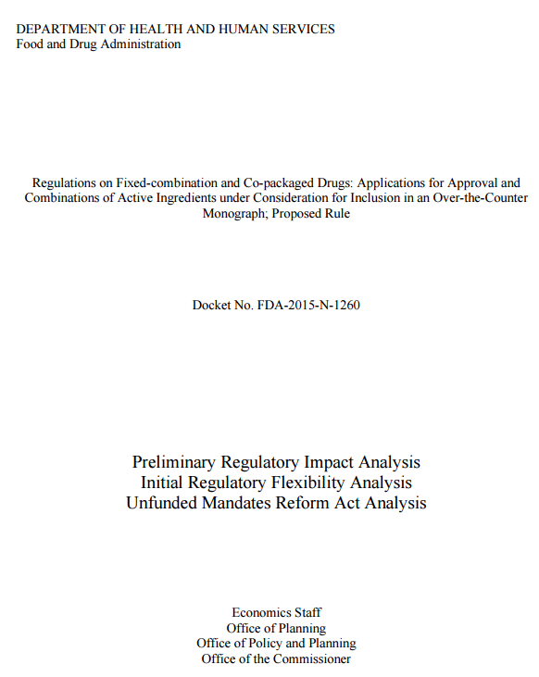
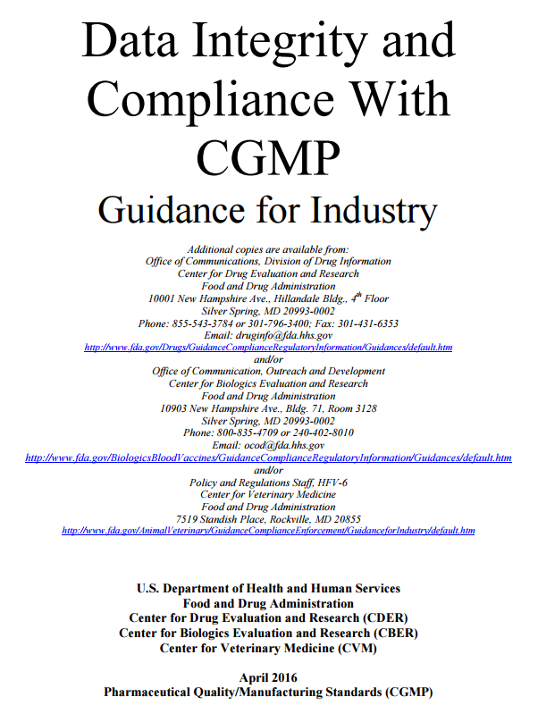
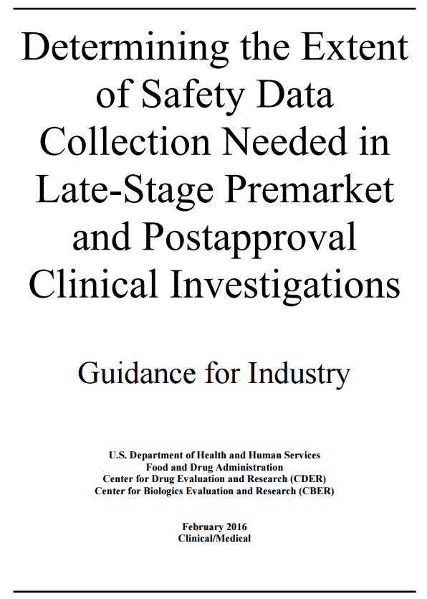
PHARMA
Access to Investigational Drugs
Rx and OTC Co-Packaged Drugs
Data Integrity
Clinical Safety Data Collection
Year-in-Review 2016
www.potomacriverpartners.com

Slide 53
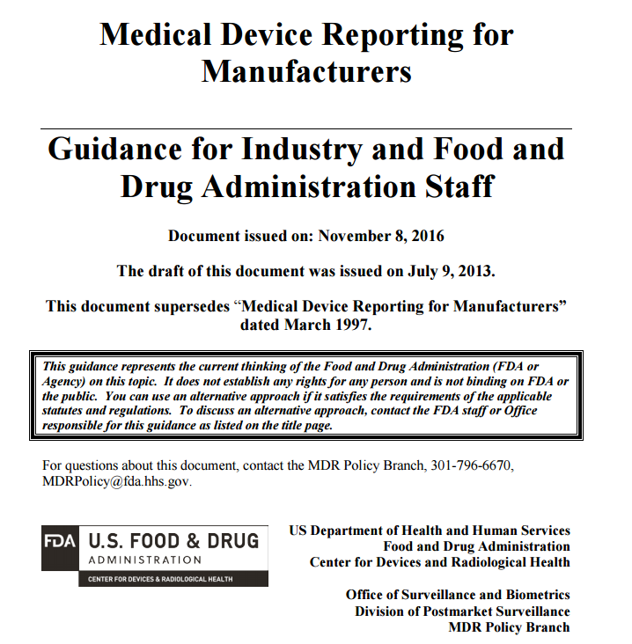
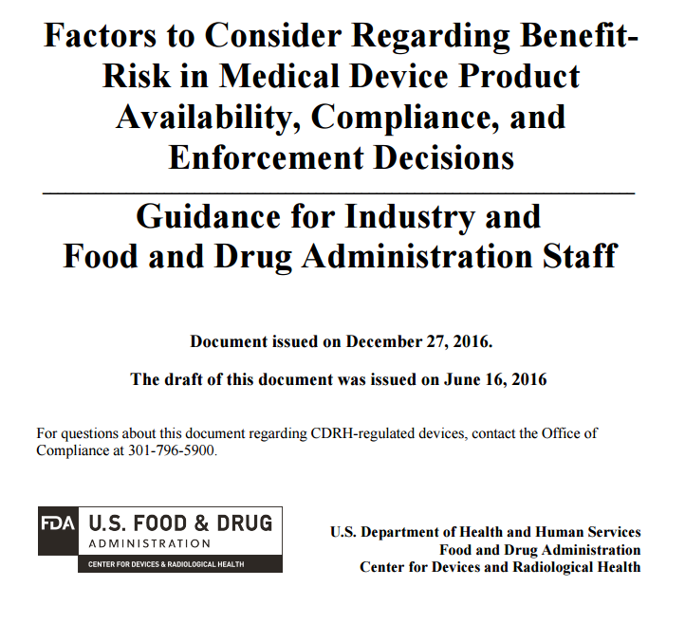
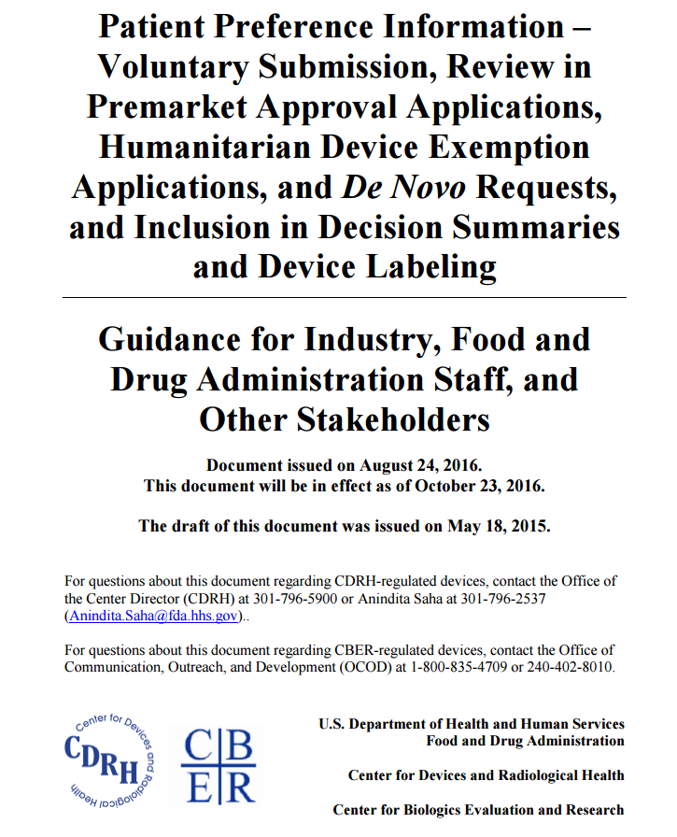
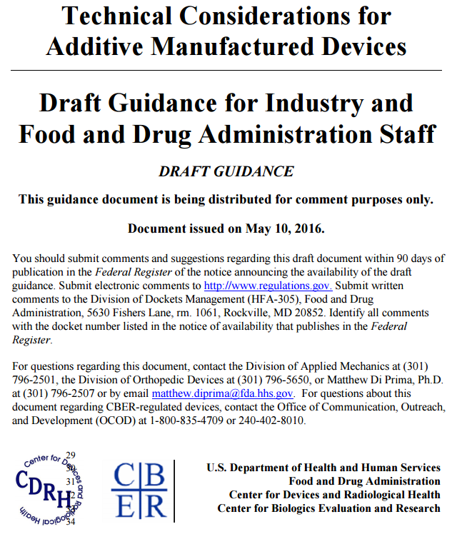
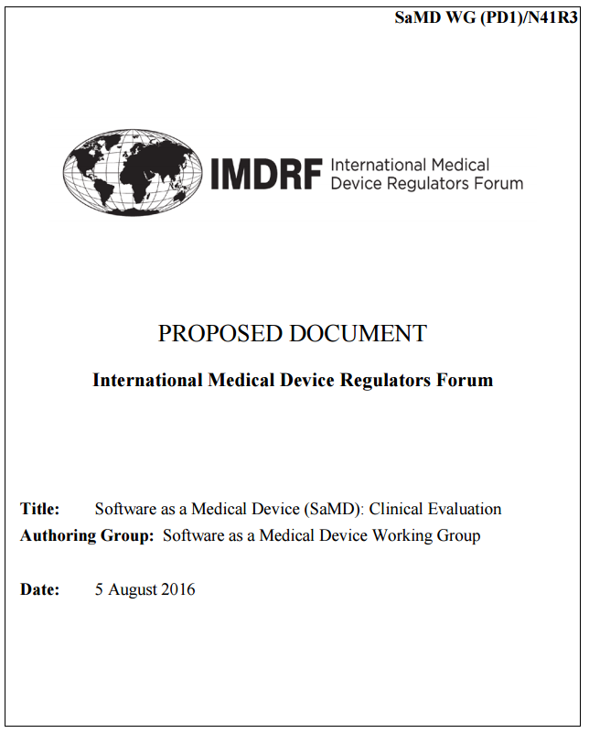
DEVICE
Device Adverse Events Reporting
Benefit/Risk Determinations
Patient Preference Information
3D Printing
Software as a Device
Year-in-Review 2016
www.potomacriverpartners.com

Slide 54
FDA LETTERS
Year-in-Review 2016
www.potomacriverpartners.com

Slide 55
FDA sent Pfizer Hospira unit Untitled Letter for misleading YouTube ad
Year-in-Review 2016
www.potomacriverpartners.com

Slide 56
FDA sent Warning Letter to Shionogi for copay voucher claims
Year-in-Review 2016
www.potomacriverpartners.com

Slide 57
COMPLIANCE NEWS
Year-in-Review 2016
www.potomacriverpartners.com

Slide 58
OpenTrials website launched
Advocate Health paid largest ever HIPAA settlement
Zimmer Biomet breached Deferred Prosecution Agreement
FDA held hearing on off-label communications
False Claims Act penalties doubled
Feds requested info on 80,000 doctor events from Novartis
PhRMA / BIO released new communication guidelines
Year-in-Review 2016
www.potomacriverpartners.com

Slide 59
INTERNATIONAL ENFORCEMENT
Year-in-Review 2016
www.potomacriverpartners.com

Slide 60
UK fined GSK $54.3 million
in pay-for-delay antitrust probe
Six former and current Novartis execs indicted for bribery in South Korea
Association of the British Pharmaceutical Industry (ABPI) suspended Astellas UK for deception
China arrested 324 suspects in illegal vaccine sales probe
Competitions and Market Authority fined Pfizer and
Flynn Pharma $110 million
for price hikes
China fined Medtronic
$17.2 million for price fixing its cardiovascular and diabetes devices
Year-in-Review 2016
www.potomacriverpartners.com

Slide 61
INTERNATIONAL COMPLIANCE NEWS
Year-in-Review 2016
www.potomacriverpartners.com

Slide 62
Thai FDA (TFDA) issued new medical device reporting requirements
EMA revised first-in-human trials guidelines
Swiss pharmaceutical companies published payments for health services and consultations
Experimental Bial drug trial left one man dead
UK investigated Concordia for specialty generics pricing, CEO steps down
EMA released framework for interaction between Agency and industry
EDMA and Eucomed approved new Code of Ethical Business Practice
EU device and diagnostic trade groups consolidated to form Medtech Europe
China’s Medical Device Good Clinical Practices went into effect June 1, 2016
UK ABPI published first Transparency Data
Canada released new CME standards for commercial support
Japan will increase frequency of drug price reviews
Teva investigating allegations of bribery in Romania
Novartis investigating bribery allegations in Turkey
Europe approved new Transatlantic data transfer deal
Year-in-Review 2016
www.potomacriverpartners.com

Slide 63
2017 is already off to a fast start…
Year-in-Review 2016
www.potomacriverpartners.com

Slide 64
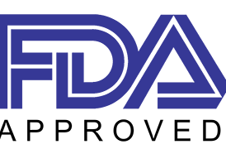
$30 million to settle FCPA violations in Brazil and Mexico
$350 million to settle False Claims Act allegations
Released guidance on communications with payors and formulary committees
$17.4 million to resolve FCPA allegations
$100 million to settle FTC charges
$150 million for opioid reporting violations
Year-in-Review 2016
www.potomacriverpartners.com

Slide 65
ARE YOU READY FOR 2017?
Year-in-Review 2016
www.potomacriverpartners.com

Slide 66
Brought to you by:
Call us at 703.430.5944
or visit www.PotomacRiverPartners.com
Year-in-Review 2016
www.potomacriverpartners.com

Slide 67
FRONT PAGE NEWS
CIVIL SETTLEMENTS
http://www.businessinsider.com/mylan-ceo-heather-bresch-house-oversight-committee-hearing-epipen-2016-9
https://www.nytimes.com/2016/12/08/business/insys-therapeutics-arrests-fentanyl.html
http://www.fcpablog.com/blog/2016/2/4/sciclone-pays-sec-128-million-to-settle-china-fcpa-offenses.html
http://www.fcpablog.com/blog/2016/6/21/analogic-pays-148-million-to-resolve-fcpa-offenses.html
http://www.fcpablog.com/blog/2016/9/30/gsk-pays-sec-20-million-to-settle-china-fcpa-violations.html
http://www.fcpablog.com/blog/2016/12/22/teva-announces-519-million-fcpa-settlement.html
http://www.reuters.com/article/us-merck-vioxx-settlement-idUSKCN0UT1PX
https://drugsafetynews.com/2016/11/19/johnson-johnson-seek-change-venue-talcum-powder-cases/
https://www.bloomberg.com/news/articles/2016-12-01/j-j-ordered-to-pay-more-than-1-billion-for-pinnacle-hip-device
http://www.reuters.com/article/us-johnsonandjohnson-hips-ruling-idUSKCN0ZM212
https://www.drugwatch.com/2016/01/26/jj-faces-800-m-levaquin-lawsuit/
https://www.drugwatch.com/2016/02/03/jj-settles-mesh-cases-for-over-120m/
https://www.statnews.com/pharmalot/2016/07/05/johnson-johnson-70-million-risperdal-boys/
http://www.njlawjournal.com/id=1202763382908/18-Million-in-Judgments-Reversed-in-Accutane-Litigation?mcode=0&curindex=0&curpage=ALL&slreturn=20170025103813
https://www.knobbe.com/news/2016/12/ranbaxy-and-astrazeneca-prevail-nexium%C2%AE-pay-delay-case
https://www.bloomberg.com/news/articles/2016-04-07/abbott-defeats-1-billion-lawsuit-over-stent-marketing
https://www.bloomberg.com/news/articles/2016-04-06/pfizer-wins-dismissal-in-zoloft-birth-defect-warning-cases
FEDERAL SETTLEMENTS
https://www.justice.gov/opa/pr/medical-equipment-company-will-pay-646-million-making-illegal-payments-doctors-and-hospitals
https://www.justice.gov/opa/pr/wyeth-and-pfizer-agree-pay-7846-million-resolve-lawsuit-alleging-wyeth-underpaid-drug-rebates
http://www.fcpablog.com/blog/2016/2/4/sciclone-pays-sec-128-million-to-settle-china-fcpa-offenses.html
https://www.justice.gov/opa/pr/united-states-settles-false-claims-act-allegations-against-21st-century-oncology-347-million
https://www.justice.gov/opa/pr/respironics-pay-348-million-allegedly-causing-false-claims-medicare-medicaid-and-tricare
https://www.sec.gov/news/pressrelease/2016-59.html
https://www.justice.gov/opa/pr/pharmaceutical-companies-pay-67-million-resolve-false-claims-act-allegations-relating-tarceva
https://www.sec.gov/Archives/edgar/data/1270073/000114420416098466/v438643_8k.htm
https://www.statnews.com/pharmalot/2016/05/12/aegerion-settlement-40-million/
https://www.justice.gov/usao-sdny/pr/manhattan-us-attorney-announces-54-million-settlement-against-salix-pharmaceuticals
https://www.justice.gov/opa/pr/analogic-subsidiary-agrees-pay-more-14-million-resolve-foreign-bribery-charges
https://www.justice.gov/usao-wdnc/pr/medical-device-company-agrees-pay-8-million-resolve-claims-it-paid-illegal-kickbacks
https://www.justice.gov/opa/pr/johnson-johnson-subsidiary-acclarent-inc-pays-government-18-million-settle-false-claims-act
https://www.treasury.gov/resource-center/sanctions/CivPen/Documents/20160705_alcon.pdf
https://www.sec.gov/litigation/admin/2016/34-78730.pdf
https://www.sec.gov/litigation/admin/2016/34-79005-s.pdf
https://www.justice.gov/opa/pr/nation-s-largest-nursing-home-pharmacy-pay-over-28-million-settle-kickback-allegations
https://www.sec.gov/news/pressrelease/2016-277.html
https://www.justice.gov/opa/pr/forest-laboratories-and-forest-pharmaceuticals-pay-38-million-resolve-kickback-allegations
STATE LAW UPDATES
http://www.policymed.com/2016/01/washington-dc-changes-pharmaceutical-detailer-license-requirements.html
http://www.goldwaterinstitute.org/en/work/topics/healthcare/right-to-try/california-becomes-32nd-state-to-adopt-right-to-tr/
https://www.cga.ct.gov/2016/act/pa/pdf/2016PA-00214-R00SB-00371-PA.pdf
http://goldwaterinstitute.org/en/work/topics/healthcare/right-to-try/idaho-becomes-25th-state-to-adopt-right-to-try-law/
http://legislature.maine.gov/legis/bills/getPDF.asp?paper=HP0138&item=3&snum=127
http://blog.tenthamendmentcenter.com/2016/03/west-virginia-house-passes-right-to-try-act-taking-on-some-fda-restrictions-on-terminal-patients-100-0/
http://www.raps.org/Regulatory-Focus/News/2016/12/06/26309/Vermont-Drug-Price-Transparency-New-Law-Calls-Out-Egregious-Price-Spikes/
https://www.cga.ct.gov/2015/ACT/PA/2015PA-00004-R00SB-00257-PA.htm
http://www.chicagotribune.com/business/ct-pharma-sales-licenses-chicago-1117-biz-20161116-story.html
INDIVIDUAL RESPONSIBILITY
STATE SETTLEMENTS
https://www.nytimes.com/2016/12/08/business/insys-therapeutics-arrests-fentanyl.html
https://www.statnews.com/2016/07/08/theranos-elizabeth-holmes-banned/
https://www.healthlawpolicymatters.com/2016/06/27/jury-acquits-former-warner-chilcott-president-in-one-of-first-prosecutions-of-a-health-care-executive-following-dojs-yates-memo/
https://www.law360.com/articles/856721/ex-warner-chilcott-rep-gets-probation-for-hipaa-violation
https://www.nytimes.com/2016/11/18/business/valeant-philidor-fraud-kickback-scheme.html
http://www.cbsnews.com/news/kentucky-settles-lawsuit-with-oxycontin-maker-for-24-million/
http://bl.risperdallawsuitcenter.com/kentucky-risperdal-lawsuit-settled-for-15-5-million/
http://bl.therisperdallawsuit.com/south-carolina-risperdal-lawsuit-verdict-pared-to-124-million/
http://www.reuters.com/article/us-endo-new-york-settlement-idUSKCN0W51YI
http://www.insurance.ca.gov/0400-news/0100-press-releases/2016/release082-16.cfm
https://ag.ny.gov/press-release/ag-schneiderman-announces-125-million-settlement-drug-company-impeded-competition
http://www.reuters.com/article/us-bristol-myers-settlement-idUSKBN13X20I
NEW FEDERAL LAWS
http://www.healthcareitnews.com/news/obama-signs-21st-century-cures-act-law-funding-precision-medicine-cancer-moonshot-ehr
SOURCES
Year-in-Review 2016
www.potomacriverpartners.com

Slide 68
PRICING
FDA GUIDANCE
http://www.forbes.com/sites/emilywillingham/2016/08/21/why-did-mylan-hike-epipen-prices-400-because-they-could/#6e184316477a
http://newsroom.mylan.com/2016-10-07-Mylan-Agrees-to-Settlement-on-Medicaid-Rebate-Classification-for-EpiPen-Auto-Injector
https://www.bloomberg.com/news/articles/2016-10-19/blumenthal-says-mylan-s-settlement-with-doj-a-sweetheart-deal
http://www.businessinsider.com/congress-taking-on-xtandi-price-2016-3
http://fortune.com/2016/09/11/justice-department-taro-pharma/
https://www.statnews.com/pharmalot/2016/10/07/ariad-riases-leukemia-drug-price/
https://consumerist.com/2016/12/15/20-states-accuse-teva-mylan-other-pharma-companies-of-price-fixing/
http://www.allergan.com/news/ceo-blog/september-2016/our-social-contract-with-patients
http://www.businessinsider.com/insulin-maker-novo-nordisk-commits-to-single-digit-price-increase-cap-2016-12
https://investor.lilly.com/releasedetail.cfm?ReleaseID=1003887
http://www.fda.gov/downloads/drugs/guidances/ucm351261.pdf
http://www.fda.gov/downloads/AboutFDA/ReportsManualsForms/Reports/EconomicAnalyses/UCM482077.pdf
http://www.fda.gov/downloads/drugs/guidancecomplianceregulatoryinformation/guidances/ucm495891.pdf
http://www.fda.gov/downloads/drugs/guidances/ucm291158.pdf
http://www.fda.gov/MedicalDevices/Safety/ReportingAllegationsofRegulatoryMisconduct/
http://www.fda.gov/ucm/groups/fdagov-public/@fdagov-meddev-gen/documents/document/ucm359566.pdf
http://www.fda.gov/downloads/medicaldevices/deviceregulationandguidance/guidancedocuments/ucm506679.pdf
http://www.fda.gov/ucm/groups/fdagov-public/@fdagov-meddev-gen/documents/document/ucm499809.pdf
http://www.fda.gov/ucm/groups/fdagov-public/@fdagov-meddev-gen/documents/document/ucm524904.pdf
OPIOID CRISIS
http://www.tennessean.com/story/news/investigations/2016/11/26/nas-loss-parental-rights/94231538/
http://www.wsj.com/articles/the-va-hooked-veterans-on-opioids-then-failed-them-again-1483030270
http://theexaminer.com/stories/news/southeast-texas-far-immune-opioid-epidemic-continuing-its-sweep-across-us
https://www.nytimes.com/2016/12/28/nyregion/fentanyl-epidemic-long-island.html
http://www.wbur.org/commonhealth/2016/09/12/opiod-hackathon
http://time.com/4542105/john-oliver-opioids-last-week-tonight/
https://www.washingtonpost.com/investigations/key-officials-switch-sides-from-dea-to-pharmaceutical-industry/2016/12/22/55d2e938-c07b-11e6-b527-949c5893595e_story.html?utm_term=.d99018973af1
http://www.rimonthly.com/Rhode-Island-Monthly/June-2016/The-Opioid-Crisis-in-Rhode-Island/
http://www.pbs.org/newshour/bb/drug-companies-helped-drive-opioid-crisis/
https://buffalonews.com/2016/12/29/wave-opioid-related-deaths-hits-erie-county/
http://www.news-herald.com/article/HR/20161226/NEWS/161229600
http://www.sun-sentinel.com/local/fl-heroin-overdose-epidemic-20161120-story.html
https://www.rt.com/usa/371980-opioid-foster-care-crisis/
http://www.illinoisattorneygeneral.gov/pressroom/2016_08/20160825.html
http://www.pharmpro.com/news/2016/06/5-drug-wholesalers-agree-settle-pill-shipment-lawsuit
https://www.statnews.com/pharmalot/2016/11/17/opioids-chicago-sales-reps/
https://ag.ny.gov/press-release/ag-schneiderman-announces-settlement-endo-health-solutions-inc-endo-pharmaceuticals
http://www.newyorkupstate.com/news/2016/12/ny_law_expands_insurance_coverage_for_heroin_opioid_addicts.html
FDA LETTERS
http://www.fda.gov/downloads/Drugs/GuidanceComplianceRegulatoryInformation/EnforcementActivitiesbyFDA/WarningLettersandNoticeofViolationLetterstoPharmaceuticalCompanies/UCM482464.pdf
http://www.fda.gov/downloads/Drugs/GuidanceComplianceRegulatoryInformation/EnforcementActivitiesbyFDA/WarningLettersandNoticeofViolationLetterstoPharmaceuticalCompanies/UCM493790.pdf
COMPLIANCE NEWS
http://opentrials.net/2016/10/10/opentrials-launches-beta-version-today-at-the-world-health-summit/
https://www.hhs.gov/about/news/2016/08/04/advocate-health-care-settles-potential-hipaa-penalties-555-million.html
http://www.fcpablog.com/blog/2016/6/16/doj-biomet-breached-dpa.html
https://www.druganddevicelawblog.com/2016/11/guest-post-the-fdas-two-day-meeting-on-manufacturer-off-label-communications.html
https://www.healthlawpolicymatters.com/2016/06/30/doj-announces-dramatic-increase-in-false-claims-act-penalties/
https://www.statnews.com/pharmalot/2016/03/28/novartis-doj-kickbacks/
http://phrma-docs.phrma.org/sites/default/files/pdf/information-sharing-with-hcps-principles-report.pdf
PATIENT ASSISTANCE PROGRAMS
https://www.bloomberg.com/news/articles/2016-05-27/gilead-subpoenaed-as-feds-probe-drugmaker-charity-connections
https://www.bloomberg.com/news/articles/2016-08-01/celgene-accused-of-using-charities-in-scheme-to-gain-billions
SOURCES
Year-in-Review 2016
www.potomacriverpartners.com

Slide 69
INTERNATIONAL ENFORCEMENT
2017 UPDATE
http://www.bloomberg.com/news/articles/2016-02-12/glaxo-fined-54-4-million-in-u-k-probe-of-pay-for-delay-deals?utm_medium=nl&utm_source=internal&mkt_tok=3RkMMJWWfF9wsRokuq3Bcu%2FhmjTEU5z17%2BosUaGwhIkz2EFye%2BLIHETpodcMSMdiMr%2FYDBceEJhqyQJxPr3HJdQN18R7RhHnDg%3D%3D
https://www.insideeulifesciences.com/2016/02/12/cma-fines-glaxosmithkline-and-several-generic-companies-45-million-for-delaying-market-entry-of-generic-paroxetine-in-the-uk/
http://www.statnews.com/pharmalot/2016/02/22/novartis-south-korea-bribes-doctors/
http://news.trust.org/item/20160329202008-ptkp8
http://www.pharmafile.com/news/505321/astellas-suspended-abpi-deception-and-other-cultural-failings??utm_medium=nl&utm_source=internal&mrkid=11548821&mkt_tok=eyJpIjoiTkRJNE9HTTBZV1U0TkRZNSIsInQiOiJWeWRvODJBUXJhcUlJQVpsXC9wRlo5MlRcL1NmV3FBUWVpMm5tQkJvXC9mdzRnRlJ6dm9sanYrVlJuRjVPQlFnelV0Q000U0Q3a00rdU1vM3RjU2pqWU90XC83RVpRTGVFT2F6dkh3bm9wa2h0aWM9In0%3D
http://www.china.org.cn/china/2016-11/07/content_39652398.htm
http://www.fdanews.com/articles/179150-ema-probing-wanbury-for-falsifying-labels
https://www.gov.uk/government/news/cma-fines-pfizer-and-flynn-90-million-for-drug-price-hike-to-nhs
http://www.reuters.com/article/us-china-antitrust-medtronic-idUSKBN13W2YN
https://www.sec.gov/news/pressrelease/2017-8.html
https://www.justice.gov/opa/pr/shire-plc-subsidiaries-pay-350-million-settle-false-claims-act-allegations
http://www.fda.gov/downloads/Drugs/GuidanceComplianceRegulatoryInformation/Guidances/UCM537347.pdf
https://www.justice.gov/opa/pr/zimmer-biomet-holdings-inc-agrees-pay-174-million-resolve-foreign-corrupt-practices-act
https://www.ftc.gov/news-events/press-releases/2017/01/mallinckrodt-will-pay-100-million-settle-ftc-state-charges-it
https://www.justice.gov/opa/pr/mckesson-agrees-pay-record-150-million-settlement-failure-report-suspicious-orders
INTERNATIONAL COMPLIANCE NEWS
http://www.bbc.com/news/world-europe-35320895
http://www.nytimes.com/2016/01/18/business/international/man-dies-in-france-after-painkiller-drug-trial.html?ref=topics&_r=1&WT.mc_id=SmartBriefs-Newsletter&WT.mc_ev=click
http://www.policymed.com/2016/01/edma-and-eucomed-adopt-code-of-business-practice-brings-changes-to-medical-congresses.html?utm_source=feedblitz&utm_medium=FeedBlitzRss&utm_campaign=FeedBlitzRss&utm_content=EDMA+and+Eucomed+Adopt+Code+of+Business+Practice+Brings+Changes+to+Medical+Congresses
http://www.policymed.com/2016/02/european-medicines-agency-framework-for-interaction-with-industry.html?utm_source=feedblitz&utm_medium=FeedBlitzRss&utm_campaign=FeedBlitzRss&utm_content=European+Medicines+Agency%3a+Framework+for+Interaction+with+Industry
http://www.policymed.com/2016/03/new-canadian-cme-standards-for-commercial-support.html?utm_source=feedblitz&utm_medium=FeedBlitzRss&utm_campaign=FeedBlitzRss&utm_content=New+Canadian+CME+Standards+for+Commercial+Support
http://www.pmlive.com/pharma_news/uk_pharma_publishes_hcp_payments_as_disclosure_database_goes_live_1053585
http://www.swissinfo.ch/eng/greater-transparency_swiss-pharma-companies-to-publish-payments-online/42231246?utm_medium=nl&utm_source=internal&mrkid=11548821&mkt_tok=eyJpIjoiT1dVNFl6VTRPVFZtWWpWaSIsInQiOiJoSG5cL1BEU0o4K0dPOEFpTGVvSzB5eFdDektrS2hwbVwvRTJBZm8rdEtJejdSczV4R0p0ZlwvaXd3WW9sZmtFZjRRXC9odUhnNmZuTjFvZzNRV09oOUQyc2p2dmtvOFpycUx2ZHJETG9ROXZ5Y0k9In0%3D
https://www.insidemedicaldevices.com/2016/05/chinas-new-medical-device-good-clinical-practices-to-go-into-effect-june-1-2016/
http://www.nytimes.com/2016/07/13/technology/europe-eu-us-privacy-shield.html?mwrsm=Email
http://eng.sfda.gov.cn/WS03/CL0757/165480.html
http://pharmaphorum.com/news/concordia-centre-drug-pricing-probe/?
http://concordiarx.com/release/?id=122572
http://www.lexology.com/library/detail.aspx?g=5393ccf4-24f4-40fd-a0d9-332ca3317a8f
http://www.raps.org/Regulatory-Focus/News/2016/11/15/26194/EMA-Revises-Guideline-on-First-in-Human-Trials/
http://uk.reuters.com/article/uk-teva-pharm-ind-probe-idUKKBN13W2Z1
http://www.timesofisrael.com/israeli-pharmaceutical-giant-teva-investigating-bribery-accusations-in-romania/
http://www.reuters.com/article/us-japan-pharmaceuticals-prices-idUSKBN14907Z
http://www.medtecheurope.org/about-us
http://www.fdanews.com/articles/179527-eu-device-trade-groups-merge-into-one-unit
SOURCES
Year-in-Review 2016
www.potomacriverpartners.com

Slide 70
Call us at 703.430.5944
or visit www.PotomacRiverPartners.com
Year-in-Review 2016
www.potomacriverpartners.com

