Slide 1
Auditing and Monitoring Strategies to Mitigate Risks of Off-Label Promotion
CBI West Coast Life Sciences Compliance Congress November 19, 2010

Slide 2
CIA Required Live Auditing/Monitoring
OIG-HHS has sent a strong signal…
Auditing/Monitoring is an essential tool for compliance departments
Company | Settlement Date | Field Ride-Alongs | Speaker Programs
Novartis | 9/29/10 | 50 | 125
Forest | 9/15/10 | 40 | 175
Allergan | 9/1/10 | 30 | 75
Ortho-McNeill-Janssen | 4/28/10 | 30 | 40
Astra-Zeneca | 4/27/10 | 75 | 250
Pfizer | 8/31/09 | 60 | 200
Lilly | 1/14/09 | 50 | N/A
Cephalon | 9/29/08 | 30 | N/A
Otsuka | 3/25/08 | 10 | N/A
BMS | 9/26/07 | 30 | N/A
Jazz | 7/13/07 | 10 | N/A
Trend toward increasing number of audits
Speaker Program reviews began in Aug 09 with Pfizer
Variability in number of audits required

Slide 3
CIA Required Retrospective Auditing/Monitoring
Company | Consulting | Research | Publications | Grants
Novartis | 50 | 20 | 25 | 30
Allergan | 30 | 20 | 25 | 30
Forest Labs | 30 | 30 | 30 | 30
Ortho-McNeil-Janssen | 10* | N/A | N/A | N/A
AstraZeneca | 70 | 30 | 50 | 60
Pfizer | 50 | N/A | 30 | 60
Lilly | N/A | N/A | N/A | N/A
Cephalon | N/A | N/A | N/A | N/A
Otsuka | N/A | N/A | N/A | N/A
BMS | N/A | N/A | N/A | 40
Jazz | N/A | N/A | N/A | N/A
Trend toward increasing number of required activities
Beyond sales and marketing activities
Minimum statistical scope
Records Review…
Sampling records
T&E/Agg. Spend records
Med Info
Verbatims
Call notes
E-mails
Manager reports
*Any fee-for-service arrangement

Slide 4
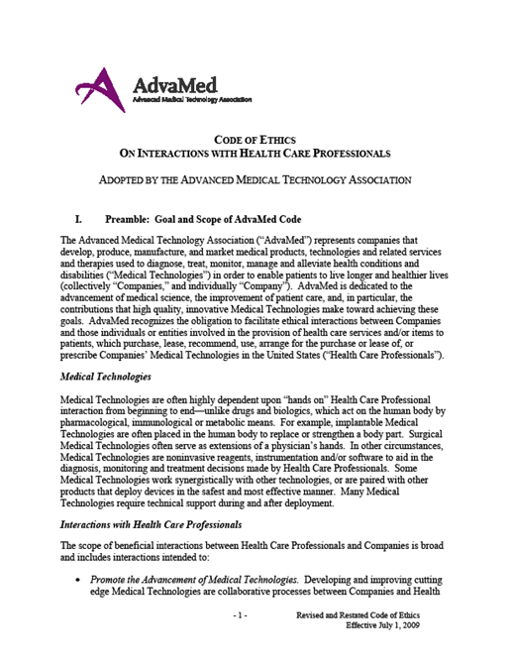
PhRMA Code and AdvaMed
“
“
…companies should periodically monitor speaker programs for compliance with FDA regulatory requirements for communications on behalf of the company about its medicines.
Companies are strongly encouraged to follow the seven elements of an effective compliance program…(5) conducting internal monitoring and auditing…
”
”
For the purpose of this presentation, we will use the term “audit” to describe reviewing field force activities

Slide 5
Planning and Conducting Live Field Auditing
Scope the Audit
Assess the budget
Identify the reach and define the protocol
Select the team
Scope the Audit
Develop Materials
Provide learning aids
Standardize tools
Educate the team
Provide Results
Audit
Process
Develop Materials
Communicate
Set the tone
Communicate to the representatives
Communicate
Provide Results
Observations → findings
Create an audit report

Slide 6
Scope the Audit
Scoping the Audit
How many audits?
Who, what or when to audit?
Key Questions
How much budget do we have?
What is the greatest risk(s)?
Create
Long term audit plan for 3-5 years to help balance resources and risks

Slide 7
Scope the Audit: Assess the budget
Audits are expensive
Resources and travel
Transportation, accommodations, and time out of the office
Set budget in advance
Maximizes audit dollars
Ensure you can meet the scope

Slide 8
Scope the Audit: Identify the reach
Define the scope
Key considerations
What products present the highest risk?
Has a specific territory or region been investigated multiple times?
What audits have been previously conducted or planned ?
Broad focus or narrow focus, or in between

Slide 9
Scope the Audit: Determining Highest Risks
Warning Letters
Internal Findings
Off-label Indications
Identify additional areas of concern:
Policies Procedures Training

Slide 10
Scope the Audit: Territory Selection Example
Washington
Montana
West Cities
Seattle
Denver
Milwaukee
St. Louis
Houston
North Dakota
Minnesota
Travel Schedules
Travel to Location on Monday
Three Audit Days (Tues-Fri)
Multiple locations via major airports
Example of 30 “Audits”
Each consisting of a ride-along and speaker program
Three days in the field for 10 weeks
Oregon
Idaho
Wyoming
South Dakota
Wisconsin
California
Iowa
Nevada
Nebraska
Utah
Kansas
Missouri
Colorado
HQ
Arizona
Oklahoma
Arkansas
New Mexico
Texas
Louisiana
Maine
Vermont
New Hampshire
East Cities
Chicago
Orlando
Raleigh
Pittsburgh
New York
New York
Massachusetts
Rhode Island
Michigan
Connecticut
Ohio
Pennsylvania
New Jersey
Illinois
Indiana
Maryland
Delaware
West Virginia
Virginia
Kentucky
North Carolina
Tennessee
South Carolina
Mississippi
Alabama
Georgia
Florida

Slide 11
Scope the Audit: Select the Audit Team
Internal or External
Understanding of:
Audit principles
Compliance issues
Product specific risks
Medical terminology
General understanding of products being audited
Project Leader
Helps coordinate logistics
Be aware of travel demands
Comfortable with the auditing

Slide 12
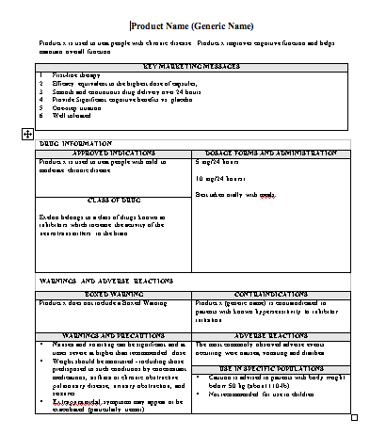
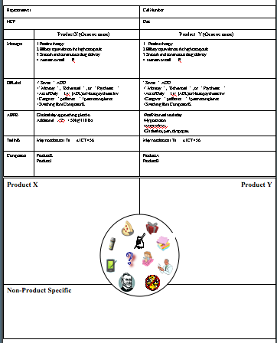
Develop of Audit Materials: Documentation
Preparation is crucial
Formalized training and audit materials
Product information guides
FAQ’S
Audit observation sheets
Develop an audit protocol
Specific parameters being audited
Guidance for handling potential situations
Stay in scope!

Slide 13
Develop Audit Materials: Training
Know science behind products
Work with Medical, Legal, Regulatory and others to obtain current information
Formal training program
Scientific information about the product(s)
Scope the protocol of the audit
Appropriate interactions with sales representatives
Responses to questions from the sales representatives, HCPs, and other individuals
Auditor behavior
Train on appropriate behavior
How to introduce yourself

Slide 14
Communication: Set the Tone
Tone at the top
Broad-based communication plan
Inform Managers
Inform Reps
Required participation
Request cooperation
Helps ensure compliance
Determine follow-ups
How information will be communicated after the audit?
Senior Management communication
Importance of the audit
Legal
requirements

Slide 15
Communication: Before and During the Audit
Put the Sales Representative at Ease
Explain the purpose of the audit
Assure the representative they are not individually targeted
Focus on the audit as a compliance initiative
Non-interference
Meet with the Representative prior to starting the day

Slide 16
Provide Results: Team Meetings
Standardization of results
Ensures consistency
Provides guidance to future auditors
Team should hold status meetings
Discuss concerns and initiated changes
Out-of-scope observations
Status meetings help the team to discuss and educate one another during the course of the audit

Slide 17
Audit Results: Observations vs. Findings
Audit Observations
Initial results that may have the potential to violate policy or law
Audit Findings
Confirmed violations of policy or law

Slide 18
Audit Results: Processing the Information
RIDE-ALONG
Audit # | Findings | Priority
1 | Observation 1 Observation 2 | High Med
2 | Observation 1 Observation 2 | Low High
… | Observation 1 Observation 2 | Med Low
30 | Observation 1 Observation 2 | Low Low
Previous
audits
Speaker Programs
Audit # | Findings | Priority
1 | Observation 1 Observation 2 | High Med
2 | Observation 1 Observation 2 | Low High
… | Observation 1 Observation 2 | Med Low
30 | Observation 1 Observation 2 | Low Low
Quantitative Findings
Root Cause Analysis
Recommendations

Slide 19
Audit Results: The Audit Report
Differentiate between observations and findings
Corrective and Preventive Action (CAPA) Plan
Fix the immediate problem (CA)
Uncover the root cause of the violation
Hypothesize then confirm underlying cause
Issue recommendation
Develop specific recommendations to limit future occurrences (PA)
CAPA
Correct
Prevent
Plan the audit for the following year(s)

Slide 20
Helpful Tips
Stay within scope
Make use of the available resources
Develop protocols for cancellations
Limit the number or auditors
Set a timeframe for follow-ups

Slide 21
Contact Information
Jon Wilkenfeld
President
Dan Koerner
Consultant
Tel: 703.430.5944
Cell: 610.470.7616
Fax: 703.997.7719
jwilkenfeld@potomacriverpartners.com
www.potomacriverpartners.com
Tel: 201.850.1305
Cell: 201.394.0532
Fax: 360.365.1006
dkoerner@potomacriverpartners.com
www.potomacriverpartners.com

