Slide 1
Off-Label Enforcement Activity – A Year in Review October 5, 2010

Slide 2
Overview
2010
Approximately $1.9 billion
YTD total recoveries by HHS
Currently 45 Warning Letters
YTD by DDMAC
Other industry developments
YTD Developments

Slide 3
2010 HHS Office of Inspector General (OIG) Settlements
Trends:
Large and small companies
Pharma and device
Cardiology and Neurology
$1.9 Billion YTD
Company | Month | $ M | Approved Therapeutic Areas | Product
AtriCure | January | $3.76 | Cardiology | Surgical cardiac ablation devices
Endoscopic Technologies | February | $1.4 | Cardiology | Surgical cardiac ablation devices
AstraZeneca | April | $520 | Neurology | Seroquel
Ortho-McNeil-Janssen | April | $81 | Neurology | Topamax
Allergan | August | $600 | Neurology | Botox
Forest | September | $313 | Endocrinology, Neurology | Levothroid, Celexa, and Lexapro
Novartis | September | $422.5 | Neurology, Cardiology Oncology | Trileptal, Diovan, Exforge, Tekturna, Zelnorm, Sandostatin
Update: Wright Medical Group Inc settles $7.9M kickback scheme with NJ USAO
Notes:
Levothroid – Thyroid
Celexa – anti-psychotic
Lexapro – anti-psychotic

Slide 4
2010 Off-Label Settlement Allegations
Company | Anti-Kickback Statute | False Claims Act
AtriCure | Equipment, advertising, discounts, referrals, & training | Advised hospitals to up-code procedures for reimbursement
Endoscopic Technologies | Paid kickbacks to HCPs to use its devices | Advised hospitals to up-code procedures for reimbursement
AstraZeneca | Recruitment & payment of doctors to author & promote off-label Seroquel articles | Marketed for unapproved uses
Ortho-McNeil-Janssen | Hired outside physicians to join sales reps on sales calls | Promoted drug for unapproved psychiatric uses
Allergan | Allegations of kickbacks to physicians who used Botox for cosmetic purposes | False Claims submitted for unapproved uses
Forest | Allegations of kickbacks via grants, consulting fees, meals and entertainment | Distribution of unapproved Levothroid and promoted products for off-label uses
Novartis | Allegations of kickbacks via speaker programs, ad boards, entertainment, travel and meals | Promoted Trileptal and five others for off-label uses
All Signed 5-Year Corporate Integrity Agreements (CIA)
Notes:
http://www.justice.gov/opa/pr/2010/February/10-civ-115.html
“Atricure also allegedly promoted expensive heart surgery using the company’s devices when less invasive alternatives were appropriate, advised hospitals to up-code surgical procedures using the company’s devices to inflate Medicare reimbursement, and paid kickbacks to health care providers to use its devices. “
http://www.justice.gov/opa/pr/2009/July/09-civ-681.html
“The government also alleged that Estech promoted expensive heart surgeries using the company’s devices when less invasive alternatives were appropriate, advised hospitals to up-code surgical procedures using the company’s devices to inflate Medicare reimbursements, and paid kickbacks to healthcare providers to use its devices. “
http://www.justice.gov/opa/pr/2010/April/10-civ-487.html
“Seroquel was approved for the treatment of psychotic disorders and permitted for short term treatment of schizophrenia, manic episodes, bipolar disorders and bipolar depression. However, AstraZeneca promoted Seroquel for the treatment of aggression, Alzheimer’s disease, anger management, anxiety, attention deficit hyperactivity disorder, dementia, depression and post-traumatic stress disorder, all of which were off label uses never approved by the FDA for safe, effective treatment. AstraZeneca marketed the illegal uses of the drug mainly to physicians through speakers at company-sponsored continuing medical education programs and through doctors recruited to author articles discussing the drug’s application.”
http://www.justice.gov/opa/pr/2010/April/10-civ-500.html
“The company allegedly marketed the sale of Topamax by hiring outside physicians to join sales representatives on sales calls and speak at events promoting the drug for off-label uses.”
http://www.justice.gov/opa/pr/2010/May/10-civ-522.html
http://www.justice.gov/opa/pr/2010/September/10-civ-988.html
http://www.justice.gov/opa/pr/2010/September/10-civ-1028.html
http://blogs.findlaw.com/decided/2010/09/allergan-inc-settles-botox-off-label-case-for-600m.html
http://www.justice.gov/opa/pr/2010/May/10-civ-522.html
http://www.justice.gov/opa/pr/2010/September/10-civ-1028.html

Slide 5
CIAs Typically Based on Seven Element Structure
Seven Elements of an Effective Compliance Program
Implement written Policies and Procedures
Designate a Compliance Officer and Compliance Committee
Conduct effective training and education
Develop effective lines of communication
Conduct internal monitoring and auditing
Enforce standards through well-publicized disciplinary guidelines
Respond promptly to detected problems and implement corrective actions
Source: US Department of Health & Human Services. Office of Inspector General. April 18, 2003. Compliance Program Guidance for Pharmaceutical Manufacturers.

Slide 6
General CIA Obligations
Compliance Responsibilities
Compliance Officer
Compliance Committee
Management and Boards
Written Standards
Code of Conduct
Policies & Procedures
Training and Education
Review Procedures
Systems Review
Transactions Review
Disclosure Program
Confidential hotline and inquiries database
Ineligible Persons
Notification of Government Investigations or Legal Proceedings
Notification of Communication with the FDA
Monitoring
Field Force Monitoring
Headquarters Monitoring
Notice to HCPs and Entities
Reporting of Physician Payments

Slide 7
2010 CIAs Include Some New Obligations
Board Oversight, Certification and Training
New Policies and Procedures
Compendia
Authorship of Articles
Disclosure of Payments to HCPs
Enhanced Internal Monitoring
Expanded IRO Monitoring

Slide 8
CIAs Placing Greater Responsibility on Board of Directors
Quarterly review of Compliance Program (CP)
Annual Board or Board Committee must sign resolution on review and oversight of CP
Independent Compliance Expert
Prepare a written report and review results with the Board
Newest CIAs (Forest, Novartis) require certification of expert
At least one hour of training to each member of the Board of Directors, in addition to the General Training
Addresses the responsibilities of Board of Director members and corporate governance
Notes:
Additionally Forest and OMJ include: Arrange for a review of the effectiveness of its compliance program by a compliance expert for each reporting period that must be provided to the OIG in each annual report
Retention of a Compliance Expert to:
Work plan for the Compliance Program review
Oversee the performance of the Compliance Program review
Prepare a written report about review and results
Certification of independence and objectivity by Compliance Expert*

Slide 9
Policies & Procedures Expanded to Address New Topics
Compendia
Any initial submission of information to any Compendia (e.g. Drugdex) and subsequent updates in connection with the determination of coverage by a Federal health care program for the Product
Annual review of all arrangements, processing fees, or other payments or financial support to any Compendia.
Authorship
Authorship criteria for publications about Government Reimbursed Products or therapeutic areas that may be treated with Government Reimbursed Products
Disclosure of financial relationships between the author and company
Identification of all authors or contributors (including professional writers) associated with a given publication
Scope and breadth of research results made available to each author or contributor

Slide 10
Disclosure of Payments to HCPs
Company | Date Announced | Date Released | Frequency | Rationale/ Timing
Lilly | 9/24/08 | 7/31/09 | Quarterly | CIA signed: 1/14/09
Cephalon | 9/29/08 | 1/31/10 | Annual 2009 | CIA signed: 9/29/08
Pfizer | 2/09/09 | 3/31/10 | Bi-Annual: ’09 Annual: ’10 Quarterly: ’11 | CIA signed: 8/31/09
J&J | 5/07/09 | 6/29/10 | Bi-Annual: ’10 Quarterly: ’11 | Ortho-McNeil -Janssen CIA signed: 4/28/10 Voluntary for remainder of pharma companies
AstraZeneca | 5/21/09 | Aug ‘10 | Bi-Annual: ’10 Quarterly: ’11 | CIA signed: 4/27/10
Allergan, Inc. | 8/30/10 | 4/30/11 | 2H ’10, 1H ’11 Quarterly: (Q3 ’11) | CIA signed: 8/30/10
Forest Labs | 9/15/10 | 1/1/11 | Quarterly: ’11 | CIA signed: 9/15/10
Novartis | 9/29/10 | 3/31/11 | Quarterly: ’11 | CIA signed: 9/29/10
Key
= Currently disclosing
= Planned disclosure

Slide 11
Field Force Monitoring (Live)
Trend toward increasing number of live ride-alongs
Speaker Program reviews began in Aug 09 with Pfizer CIA
Variability in number of audits required
Company | Field Ride-Alongs | Live Speaker Program Audits
Novartis | 50 | 125
Allergan | 30 | 75
Forest Labs | 40 | 175
Ortho-McNeil-Janssen | 30 | 40
AstraZeneca | 75 | 250
Pfizer | 60 | 200
Lilly | 50 | N/A
Cephalon | 30 | N/A
Otsuka | 10 | N/A
BMS | 30 | N/A
Jazz | 10 | N/A
2010

Slide 12
Retrospective Monitoring
Trend toward increasing number of required activities
Beyond sales and marketing activities
Minimum statistical scope
Company | Consulting | Research | Publications | Grants
Novartis | 50 | 20 | 25 | 30
Allergan | 30 | 20 | 25 | 30
Forest Labs | 30 | 30 | 30 | 30
Ortho-McNeil-Janssen | 10* | N/A | N/A | N/A
AstraZeneca | 70 | 30 | 50 | 60
Pfizer | 50 | N/A | 30 | 60
Lilly | N/A | N/A | N/A | N/A
Cephalon | N/A | N/A | N/A | N/A
Otsuka | N/A | N/A | N/A | N/A
BMS | N/A | N/A | N/A | 40
Jazz | N/A | N/A | N/A | N/A
*Any fee-for-service arrangement

Slide 13
Increased Scope of IRO Systems Review on Clinical Side
Third party Independent Review Organization (IRO) is charged with performing a systems review
Boston Scientific CIA (Dec 09) included IRO review of all post-market clinical studies
The CIA specifies 9 factors the IRO must consider in its review of post-market studies
Notes:
The purpose of the research;
Whether the research has been IRB-approved;
Will study participation require subjects to make extra visits to HCPs; who will pay for the visits; how much will be paid?
How long will the study continue;
Whether there is a control group;
What will the subjects be told when the study ends;
Are subjects informed that the issue of whether the device is the best treatment remains a research question;
Whether every piece of data collected has been verified;
The names/credentials of each person who designed the study and any underlying protocol.

Slide 14
Review of FDA Warning Letters

Slide 15
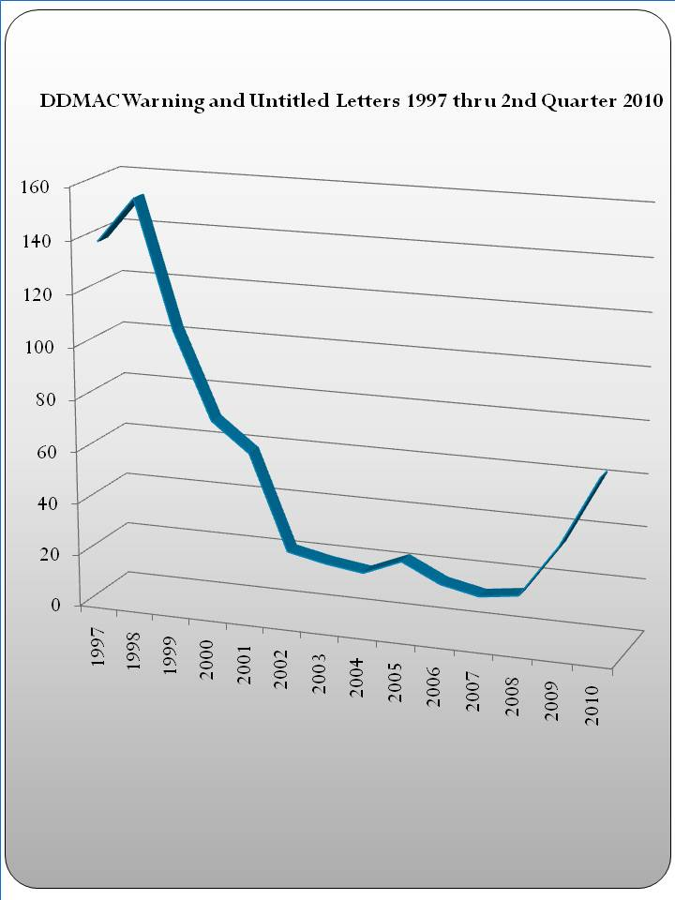
1997-2010 DDMAC Warning Letters by Year
Rapid decline between 1998 and 2002
Peaked at 150 Warning Letters in 1998
Consistently low (~20) 2002-08
Increasing volume since 2008
Still at only 40% of peak 1998 volume
Source: http://www.eyeonfda.com/eye_on_fda/2010/09/qualitative-look-at-ddmac-nov-and-warning-letters-during-1st-and-2nd-quarters-2010.html
Notes:
Source for graph on left: http://www.eyeonfda.com/eye_on_fda/2010/09/qualitative-look-at-ddmac-nov-and-warning-letters-during-1st-and-2nd-quarters-2010.html

Slide 16
Greater Emphasis on External Monitoring by FDA in 2010
2009 and 2010 Warning Letters by Surveillance Mechanism
Slight increase (17%) in Monitoring & Surveillance activity (18 to 21)
However, 13 of 18 2009 M&S warning letters due to sponsored links
Removing sponsored link letters results in significant increase in monitoring
Submissions via 2253 relatively constant
24
23
18*
21
* Include 13 Warning Letters Issued on 4/2/09 for “sponsored links”
Notes:
How
Who
What
Why

Slide 17
FDA Slightly Shifting Focus Towards Smaller Companies
13
18
27
28
N=41*
Jan-Dec 2009
N=45
Jan-Sept 2010
Sources: http://pharmexec.findpharma.com/pharmexec/data/articlestandard//pharmexec/222010/671415/article.pdf
http://www.fda.gov/Drugs/GuidanceComplianceRegulatoryInformation/EnforcementActivitiesbyFDA/WarningLettersandNoticeofViolationLetterstoPharmaceuticalCompanies/ucm197224.htm
Notes:
http://pharmexec.findpharma.com/pharmexec/data/articlestandard//pharmexec/222010/671415/article.pdf

Slide 18
FDA has Switched Emphasis Towards Physician Communication
19
23
27
24
N=42*
Jan-Dec 2009
N=51*
Jan-Sept 2010
* Larger sample size due to warning letters identified for both
Notes:
Patients= DTC, social media, website, video, patient brochure
Doctors= Journals, reps, detail aid, patient profile piece,
signage, and misc. hcp promo,

Slide 19
Enforcement Focused on Both Web and Traditional Promotion
2010 DDMAC Warning Letters by Activity

Slide 20
Trend Towards Increased Emphasis on Efficacy, Superiority
2009-2010 DDMAC Warning Letters by Cited Violation
Almost all of 2010 warning letters included overstating efficacy
Consistent focus on omission of risk information or other material information
Minimal amount of warning letters address “false or misleading claims or presentations”
Notes:
Unsubstantiated Superiority Claims
Overstates Efficacy
Omits risk info and/ material info
Broadens Indication
False or misleading claim or presentation

Slide 21
Sample of Notable Warning Letters
Novartis Pharmaceutical Corporation: Tasigna
HCP and Consumer web pages included a “Facebook Share” widget
Stated shared content makes suggestions about efficacy without any risk information (note: bold in original text)
Expansion of efficacy and superiority (“next generation”)
Failure to submit content as part of 2253 process
AstraZeneca LP: Seroquel XR
Released after Seroquel Corporate Integrity Agreement
“Leave behind sheet” was misleading due to overstating efficacy and omitting material facts and risks
Sources: http://www.fda.gov/downloads/Drugs/GuidanceComplianceRegulatoryInformation/EnforcementActivitiesbyFDA/WarningLettersandNoticeofViolationLetterstoPharmaceuticalCompanies/UCM221325.pdf,
http://www.fda.gov/downloads/Drugs/GuidanceComplianceRegulatoryInformation/EnforcementActivitiesbyFDA/WarningLettersandNoticeofViolationLetterstoPharmaceuticalCompanies/UCM221315.pdf

Slide 22
Sample of Notable Warning Letters
Novartis Oncology: Gleevec
Reference content on Novartis-sponsored websites, GISTalliance.com, CMLalliance.com
“While not using the established name of the Novartis drug product…the websites…promote this drug product for the treatment of GIST tumors and CML.”
Websites are “perceptually similar” including color schemes etc.
Violations include: Promotion of Unapproved Use, Omission and Minimization of Risk, Unsubstantiated Dosing Claims,
Baumann Cosmetic and Research Institute: Dysport
Pre-approval promotion by Principal Investigator, Dr. Leslie Baumann
Statements made on Today Show and Elle and allure magazines
21 CFR 312.7(a): “A sponsor or investigator…shall not represent in a promotional context…”
Sources: http://www.fda.gov/ICECI/EnforcementActions/WarningLetters/ucm210191.htm,
http://www.fda.gov/downloads/Drugs/GuidanceComplianceRegulatoryInformation/EnforcementActivitiesbyFDA/WarningLettersandNoticeofViolationLetterstoPharmaceuticalCompanies/UCM198400.pdf
Notes:
Promotion of Unapproved Drug

Slide 23
Industry Developments

Slide 24
FDA Launches “Bad Ad” Program
FDA concerned about promotional activities in private
FDA-sponsored educational outreach effort administered by the agency’s Division of Drug Marketing, Advertising, and Communications (DDMAC)
Allows for anonymous reporting of “potential problems”
Health care professionals are encouraged to report violations in drug promotion by sending an email to badad@fda.gov or calling 877-RX-DDMAC
Notes:
Prescription drug advertising must:
Be accurate
Balance the risk and benefit information
Be consistent with the prescribing information approved by FDA
Only include information that is supported by strong evidence from clinical studies
What types of promotion does DDMAC regulate?
Sales representative presentations
Speaker program presentations
TV and radio advertisements
All written or printed prescription drug promotional materials
DDMAC does not regulate promotion of:
Over-the-Counter Drugs
Dietary Supplements
Medical Devices
Common Violations:
Omitting or downplaying of risk
Overstating the effectiveness
Promoting off-label, or unapproved, uses
Misleading drug comparisons
Examples of Violations
Example of Omission of Risk
You attend a speaker program which features a slide show that presents efficacy information about Drug X, but no risk information.
This presentation would be misleading because it fails to include a fair balance of benefit and risk information for Drug X.
Example of Unapproved Use
You are in a commercial exhibit hall and a company representative tells you that a drug is effective for a use that is not in the FDA-approved product labeling.
This presentation would be illegal because it promotes an off-label use.
Example of Overstating the Effectiveness
“Doctor Smith, Drug X delivers rapid results in as little as 3 days.”
This presentation is misleading because the majority of patients studied in the clinical trials for Drug X showed results at 12 weeks, with only very few showing results in 3 days.
Frequently Asked Questions
1. Can I report anonymously?
Yes, anonymous complaints often alert FDA to potential problems. However, complaints accompanied by names and contact information are helpful in cases for which FDA needs to follow-up for more information.
2. Will DDMAC be able to stop the misleading promotion?
In many cases, yes, especially if evidence is provided. Evidence can include the actual promotional materials or documentation of oral statements made by company representatives.
3. What will happen to my complaint once I have contacted DDMAC?
The information you provide will be sent to the Regulatory Review Officer in DDMAC responsible for this class of drugs. The reviewer will evaluate it and determine if it may serve as the basis for a potential enforcement action or as valuable information for our ongoing surveillance activities.
4. How do I learn more?
To learn more about DDMAC in-service training for large medical group/hospitals or to speak directly with a DDMAC Reviewer, call 301-796-1200.
http://www.fda.gov/Drugs/GuidanceComplianceRegulatoryInformation/Surveillance/DrugMarketingAdvertisingandCommunications/ucm209384.htm

Slide 25
Former CEO of Spectranetics Indicted
George Schulte, former CEO of Spectranetics Corp., indicted on 12 counts, including conspiracy to defraud the government
Accused of illegally importing unapproved medical devices between 2003-2005
Allegedly used in patients in a clinical trial without obtaining fully-informed consent
Accused of concealing conduct from internal investigators at Spectranetics as well as from FDA and the U.S. DHS
Two other executives indicted, VP of Business Development, and Business Development Manager
FDA: “Today’s indictment sends a clear message that FDA will investigate those individuals who jeopardize the public health by importing and distributing unapproved and uncleared medical devices to U.S. consumers.”
Source: http://www.gazette.com/articles/medical-103831-office-fda.html
Notes:
Individually prosecuted DESPITE:
Leaving company in 2008
Entering into a non-prosecution agreement with DOJ in 2009 & a CIA
Paying $5M, accepting responsibility for its conduct;
FDA Office of Criminal Investigations on the indictment: “Today’s indictment sends a clear message that FDA will investigate those individuals who jeopardize the public health by importing and distributing unapproved and uncleared medical devices to U.S. consumers.”

Slide 26
GSK Launches New Incentive Compensation Model
GlaxoSmithKline has committed to changing its incentive plan
Bonuses for reps will soon be based on customer feedback and adherence to company policy and values, not sales targets
Few details about how the program will be implemented
Will rely on “customer feedback”
Adherence to company values of “transparency, integrity, respect, and patient-focus”
Insists not an effort to cut marketing costs
Source; http://pharmexec.findpharma.com/pharmexec/News+Analysis/GSK-Rethinks-Rep-Compensation/ArticleStandard/Article/detail/680852?contextCategoryId=39718

Slide 27
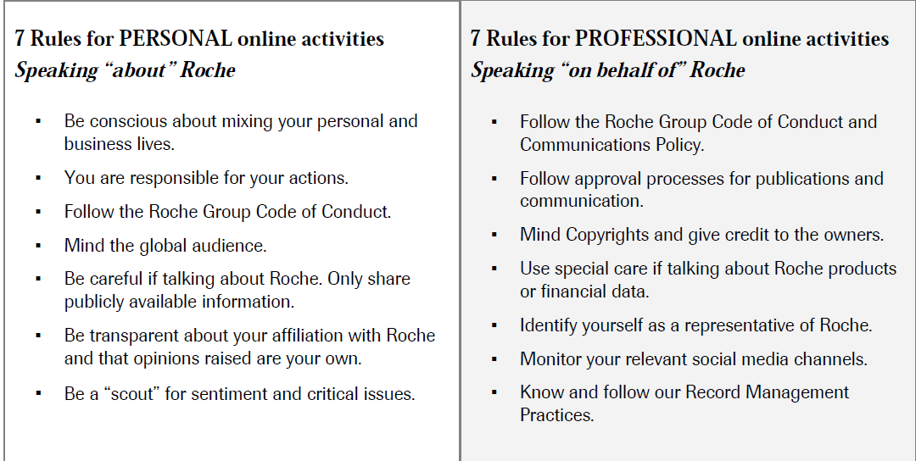
Roche Launches Internal Social Media Guidelines
Roche expands industry discussion on social media
“Use approval processes” for publications, communications
Source: http://www.roche.com/socialmedia
Notes:
http://www.roche.com/socialmedia

Slide 28
Additional Sources
http://www.justice.gov/opa/pr/2010/February/10-civ-115.html
http://www.justice.gov/opa/pr/2009/July/09-civ-681.html
http://www.justice.gov/opa/pr/2010/April/10-civ-487.html
http://www.justice.gov/opa/pr/2010/April/10-civ-500.html
http://www.justice.gov/opa/pr/2010/May/10-civ-522.html
http://www.justice.gov/opa/pr/2010/September/10-civ-988.html
http://www.justice.gov/opa/pr/2010/September/10-civ-1028.html
http://www.eyeonfda.com/eye_on_fda/2010/09/qualitative-look-at-ddmac-nov-and-warning-letters-during-1st-and-2nd-quarters-2010.html
http://www.fda.gov/Drugs/GuidanceComplianceRegulatoryInformation/EnforcementActivitiesbyFDA/WarningLettersandNoticeofViolationLetterstoPharmaceuticalCompanies/ucm197224.htm OIG CIA List
http://www.fda.gov/ICECI/CriminalInvestigations/ucm226466.htm
http://www.fda.gov/Drugs/GuidanceComplianceRegulatoryInformation/Surveillance/DrugMarketingAdvertisingandCommunications/ucm209384.htm

Slide 29
Questions

Slide 30
Thank You
Jon Wilkenfeld
President
Tel: 703.430.5944
Cell: 610.470.7616
Fax: 703.997.7719
jwilkenfeld@potomacriverpartners.com
www.potomacriverpartners.com

Slide 31
Appendix

Slide 32
9 Factors for Bona Fide Post-Market Studies (Bos Sci CIA)
The purpose of the research;
Whether the research has been IRB-approved;
Will study participation require subjects to make extra visits to HCPs; who will pay for the visits; how much will be paid?
How long will the study continue;
Whether there is a control group;
What will the subjects be told when the study ends;
Are subjects informed that the issue of whether the device is the best treatment remains a research question;
Whether every piece of data collected has been verified;
The names/credentials of each person who designed the study and any underlying protocol.

