Slide 1

Year-in-Review 2025
18TH ANNUAL

Slide 2




Year-in-Review 2025
2025
At a Glance
Trump Administration Shakes Things Up
Regulators Scrutinize DTC Promotion
Evolving AI & Digital Health Standards
Notes:
https://www.lw.com/en/insights/fda-begins-crackdown-on-direct-to-consumer-pharmaceutical-advertising

Slide 3

Potomac River Partners : 2025 Year-in-Review
TRUMP ADMINISTRATION SHAKES THINGS UP
Trump signs 217 Executive Orders

Slide 4
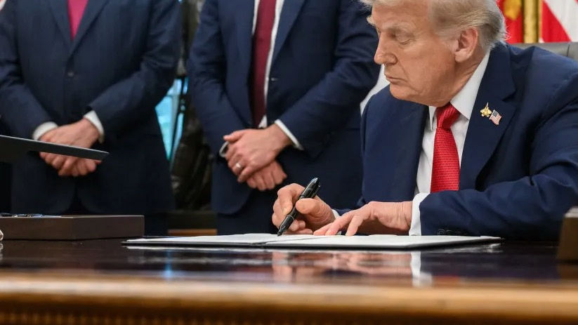
TRUMP ADMINISTRATION SHAKES THINGS UP
Trump signs 225 Executive Orders
Cuts regulations with “10-for-1 order”
Mandates review of “significant” agency rules and interpretations
Pauses then resumes FCPA enforcement
Potomac River Partners : 2025 Year-in-Review
Notes:
https://www.federalregister.gov/presidential-documents/executive-orders/donald-trump/2025
https://www.whitehouse.gov/fact-sheets/2025/01/fact-sheet-president-donald-j-trump-launches-massive-10-to-1-deregulation-initiative/
https://www.whitehouse.gov/presidential-actions/2025/02/ensuring-accountability-for-all-agencies/
https://www.whitehouse.gov/presidential-actions/2025/02/pausing-foreign-corrupt-practices-act-enforcement-to-further-american-economic-and-national-security/

Slide 5
TRUMP ADMINISTRATION SHAKES THINGS UP
Trump signs 225 Executive Orders
Directs HHS to enhance price transparency
Requires disclosure of actual prices (not estimates)
Introduces
“Most-Favored Nation”
pricing and 15% tariffs
Launches program to prioritize U.S. generics
Streamlines domestic pharma site permits
Increases foreign manufacturing inspections
Reaches U.K. trade deal to lower costs
Potomac River Partners : 2025 Year-in-Review
Notes:
https://www.whitehouse.gov/presidential-actions/2025/05/delivering-most-favored-nation-prescription-drug-pricing-to-american-patients/
https://www.whitehouse.gov/fact-sheets/2025/09/fact-sheet-president-donald-j-trump-modifies-the-scope-of-reciprocal-tariffs-and-establishes-procedures-for-implementing-trade-deals/
https://www.fda.gov/drugs/nda-and-bla-approvals/accelerated-approval-program
https://www.fda.gov/drugs/drug-safety-and-availability/fda-announces-new-anda-prioritization-pilot-support-us-generic-drug-manufacturing-and-testing

Slide 6














TRUMP ADMINISTRATION SHAKES THINGS UP
Trump signs 225 Executive Orders
Related policy action
Directs HHS to enhance price transparency
Requires disclosure of actual prices (not estimates)
Creates “Trump Rx” to lower drug costs
Announced agreements with:
Potomac River Partners : 2025 Year-in-Review
Notes:
https://www.whitehouse.gov/fact-sheets/2025/12/fact-sheet-president-donald-j-trump-announces-largest-developments-to-date-in-bringing-most-favored-nation-pricing-to-american-patients
https://www.whitehouse.gov/presidential-actions/2025/02/making-america-healthy-again-by-empowering-patients-with-clear-accurate-and-actionable-healthcare-pricing-information/
https://doggett.house.gov/media/in-the-news/wsj-white-house-unveils-trumprx-drug-buying-site-and-pfizer-pricing-deal
https://investor.lilly.com/news-releases/news-release-details/lilly-and-us-government-agree-expand-access-obesity-medicines
https://www.whitehouse.gov/fact-sheets/2025/11/fact-sheet-president-donald-j-trump-announces-major-developments-in-bringing-most-favored-nation-pricing-to-american-patients/
https://www.astrazeneca.com/media-centre/press-releases/2025/astrazeneca-announces-historic-agreement-with-us-government-to-lower-the-cost-of-medicines-for-american-patients.html
https://www.amcp.org/letters-statements-analysis/federal-update-trump-administration-announces-deal-bring-most-favored-nation-pricing-glp-1s
https://www.emdserono.com/us-en/company/news/press-releases/agreement-with-u-s-government-to-expand-access-to-ivf-therapies-16-10-2025.html

Slide 7


Potomac River Partners : 2025 Year-in-Review
REGULATORS SCRUTINIZE
DTC PROMOTION
White House memo tightens DTC enforcement
US Ramps Up DTC Enforcement

Slide 8
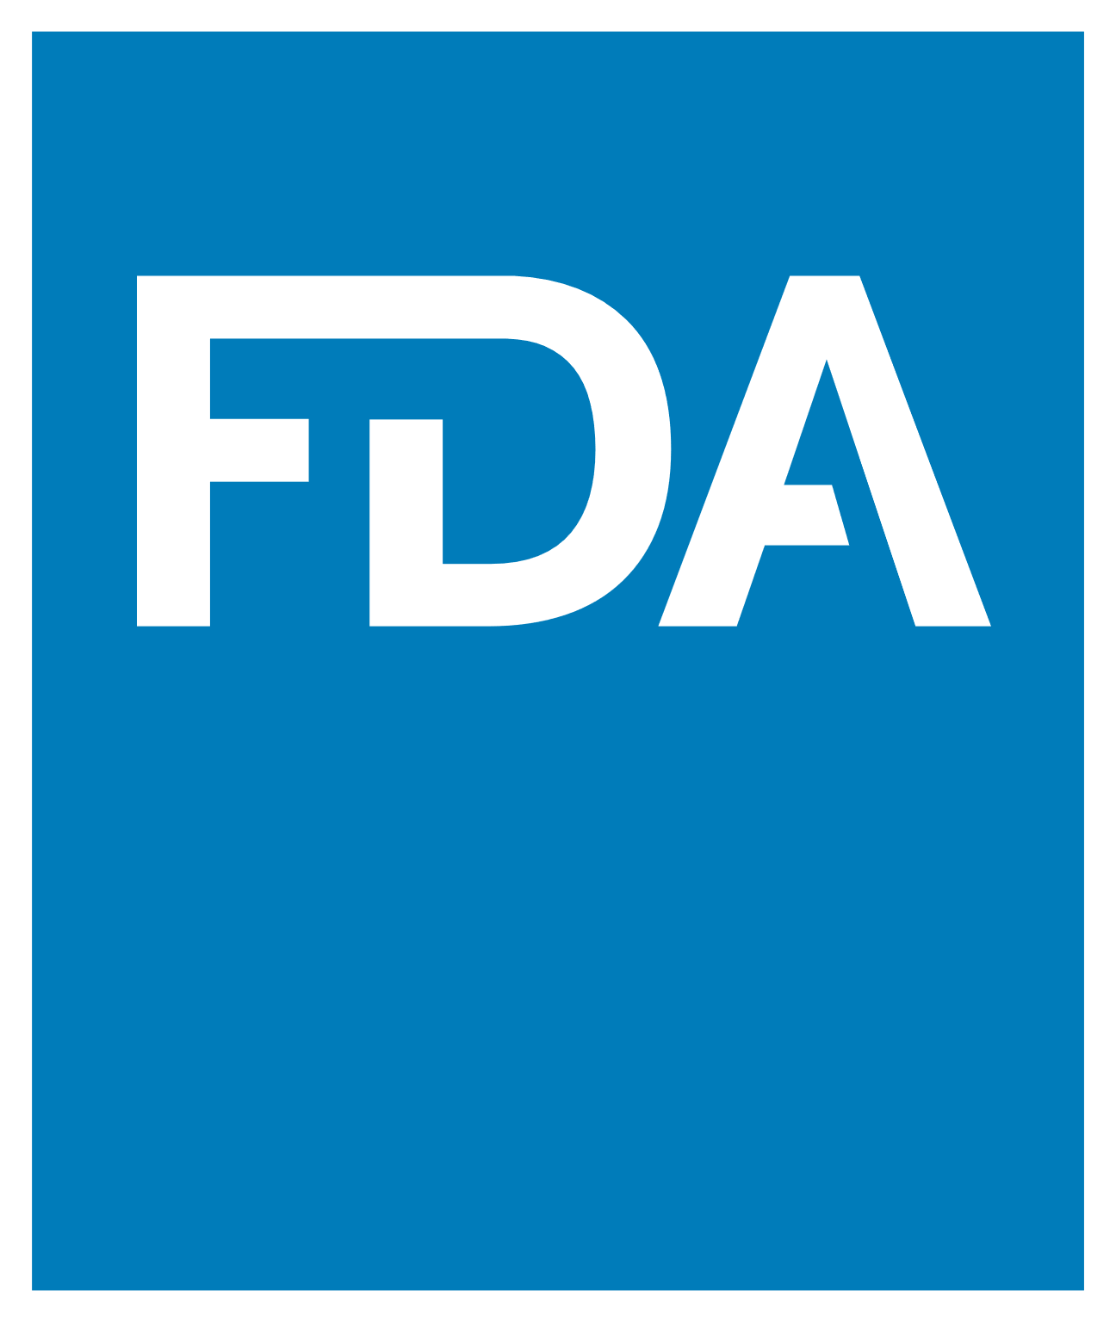
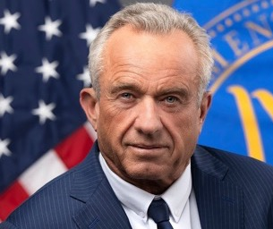
REGULATORS SCRUTINIZE DTC PROMOTION
US Ramps Up DTC Enforcement
Publicly announced 2025 DTC-Related Untitled/ Warning Letters:
White House memo seeks DTC enforcement
OPDP Publishes 74 Untitled and Warning Letters
Mainly DTC-Related
FDA cracks down on drug ads
Issues flurry of letters on same day
Notes:
https://www.whitehouse.gov/presidential-actions/2025/09/memorandum-for-the-secretary-of-health-and-human-services-the-commissioner-of-food-and-drugs/
https://www.fda.gov/news-events/press-announcements/fda-launches-crackdown-deceptive-drug-advertising

Slide 9




















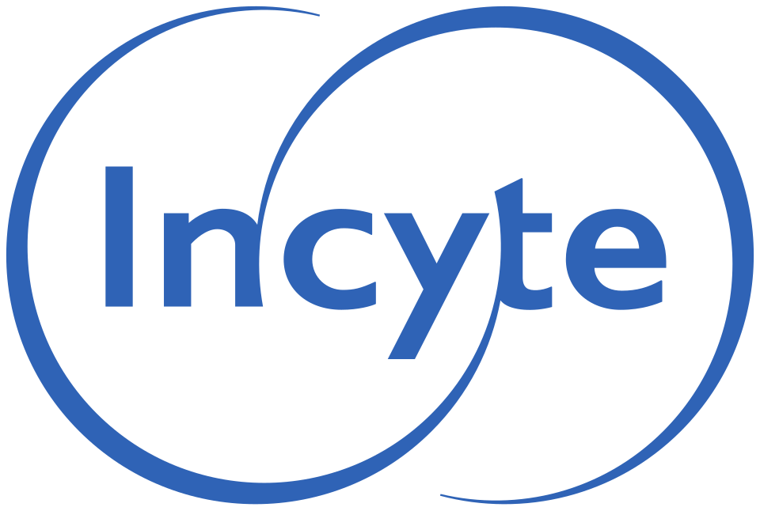



















REGULATORS SCRUTINIZE DTC PROMOTION
US Ramps Up DTC Scrutiny
DTC Regulation Receives Bipartisan Support
OPDP Publishes 74 Untitled and Warning Letters
Mainly DTC-Related
Notes:
https://www.fda.gov/drugs/warning-letters-and-notice-violation-letters-pharmaceutical-companies/untitled-letters
https://www.fda.gov/inspections-compliance-enforcement-and-criminal-investigations/compliance-actions-and-activities/warning-letters

Slide 10

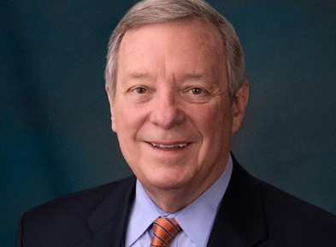
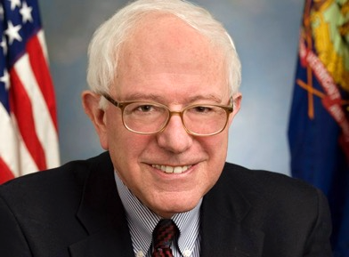
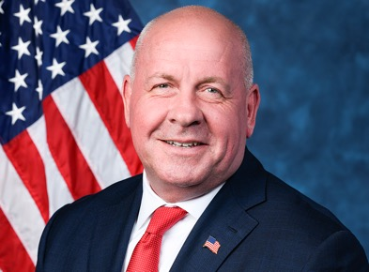
REGULATORS SCRUTINIZE DTC PROMOTION
US Ramps Up DTC Scrutiny
UK DTC Scrutiny Continues to Grow
DTC Regulation Receives Bipartisan Support
Senators investigate pharma- telehealth partnerships
Raise concerns on data sharing, promotional influence, and conflicts of interest
Finds 12 companies
in violation of ABPI Code across 20 cases
Legislators make bipartisan push for stricter DTC rules
Sen. Dick Durbin
(D-IL)
Sen. Bernie Sanders
(I-VT)
Rep. Dave Taylor
(R-OH)
Notes:
https://www.durbin.senate.gov/newsroom/press-releases/durbin-grassley-introduce-bill-to-crack-down-on-prescription-drug-advertisements-boost-price-transparency
https://schakowsky.house.gov/media/press-releases/schakowsky-taylor-introduce-bill-requiring-price-transparency-prescription

Slide 11










REGULATORS SCRUTINIZE DTC PROMOTION
UK DTC Scrutiny Continues to Grow
DTC Regulation Receives Bipartisan Support
Finds 12 companies
in violation of ABPI Code across 20 cases
Notes:
https://www.pmcpa.org.uk/cases/completed-cases/auth38431123-and-auth38441123-complainants-v-novartis/
https://www.pmcpa.org.uk/cases/completed-cases/auth38541123-complainant-v-gsk/
https://www.pmcpa.org.uk/cases/completed-cases/auth3815823-complainant-v-moderna/
https://www.pmcpa.org.uk/cases/completed-cases/auth38571123-complainant-v-astrazeneca/
https://www.pmcpa.org.uk/cases/completed-cases/auth3879224-complainant-v-pfizer/
https://www.pmcpa.org.uk/cases/completed-cases/auth38481123-complainant-v-gilead/
https://www.pmcpa.org.uk/cases/completed-cases/case02840924-voluntary-admission-by-sanofi/
https://pmcpa.org.uk/cases/completed-cases/auth3888424-complainantchief-executive-v-pfizer/
https://www.pmcpa.org.uk/cases/completed-cases/auth38611223-complainant-v-novartis-pharmaceuticals/
https://www.pmcpa.org.uk/cases/completed-cases/auth38691223-complainant-v-eli-lilly/
https://www.pmcpa.org.uk/cases/completed-cases/auth3760423-complainant-v-gsk/
https://www.pmcpa.org.uk/cases/completed-cases/case03871224-complainant-v-astrazeneca/
https://www.pmcpa.org.uk/cases/completed-cases/case02620824-complainant-v-organon/https://www.pmcpa.org.uk/cases/completed-cases/case02620824-complainant-v-organon/
https://www.pmcpa.org.uk/about-us/media/news/pmcpa-press-release-21-july-2025-case-ruled-in-breach-of-clause-2/
https://www.pmcpa.org.uk/cases/completed-cases/case02090624-complainant-v-jazz-pharmaceuticals-uk/

Slide 12

Potomac River Partners : 2025 Year-in-Review
EVOLVING AI &
DIGITAL HEALTH STANDARDS
Digital innovation meets regulatory oversight

Slide 13



EVOLVING AI & DIGITAL HEALTH STANDARDS
Digital Innovation Meets Regulatory Oversight
DOJ launches Data Security Program
FDA launches AI tool “Elsa” to modernize agency functions
Potomac River Partners : 2025 Year-in-Review
Notes:
https://www.taftlaw.com/news-events/law-bulletins/doj-data-security-program-full-enforcement-began-july-8/

Slide 14

EVOLVING AI & DIGITAL HEALTH STANDARDS
Regulatory oversight tightens on digital-health
Digital Innovation Meets Regulatory Oversight
DOJ launches Data Security Program
FDA launches “Elsa” AI tool to modernize agency functions
Potomac River Partners : 2025 Year-in-Review
Notes:
https://www.fda.gov/news-events/press-announcements/fda-launches-agency-wide-ai-tool-optimize-performance-american-people

Slide 15



EVOLVING AI & DIGITAL HEALTH STANDARDS
Regulatory oversight tightens on digital-health
Digital Innovation Meets Regulatory Oversight
FDA expands AI oversight
Defines data quality and model expectations
Creates CMS pathway for pre-authorization of digital health devices
Potomac River Partners : 2025 Year-in-Review
Notes:
https://www.taftlaw.com/news-events/law-bulletins/doj-data-security-program-full-enforcement-began-july-8/
https://www.jdsupra.com/legalnews/fda-opens-a-cms-linked-side-door-use-of-7396348/

Slide 16




EVOLVING AI & DIGITAL HEALTH STANDARDS
Digital Innovation Meets Regulatory Oversight
Global momentum accelerates regulation
Global momentum accelerates regulation
FDA establishes structured oversight
DOJ expands AI-related data security enforcement
Updates Code of Ethics reflecting digital practices
Potomac River Partners : 2025 Year-in-Review
Notes:
https://www.advamed.org/industry-updates/news/advamed-leads-with-integrity-updated-code-of-ethics-now-available/

Slide 17



EVOLVING AI & DIGITAL HEALTH STANDARDS
Digital innovation meets regulatory oversight
Global Momentum Accelerates Regulation
Shift from AI experimentation to AI compliance frameworks
IMDRF & International bodies push alignment
IMDRF seeks global alignment
EU AI Act sets obligations for high-risk digital technology
Potomac River Partners : 2025 Year-in-Review
Notes:
https://artificialintelligenceact.eu/article/16/

Slide 18

EVOLVING AI & DIGITAL HEALTH STANDARDS
Digital experimentation shifts to compliance frameworks
Global Momentum Accelerates Regulation
IMDRF seeks global alignment
Establishes guidance for AI/ML* medical devices
*ML = Machine Learning
Potomac River Partners : 2025 Year-in-Review
Notes:
https://www.fda.gov/medical-devices/software-medical-device-samd/good-machine-learning-practice-medical-device-development-guiding-principles
https://www.imdrf.org/working-groups/artificial-intelligencemachine-learning-enabled

Slide 19


Potomac River Partners : 2025 Year-in-Review
Pharma
FEDERAL SETTLEMENTS

Slide 20





FEDERAL SETTLEMENTS
Pharma
Medical Device
Medical Device
$202 million
$60 million
$4 million
AKS speaker program kickback allegations
AKS speaker program kickback allegations
FCA false promotion allegations
$280 million
FCA false reimbursement claims
Potomac River Partners : 2025 Year-in-Review
Notes:
https://www.justice.gov/usao-sdny/pr/us-attorney-announces-202-million-settlement-gilead-sciences-using-speaker-programs
https://www.justice.gov/opa/pr/pfizer-agrees-pay-nearly-60m-resolve-false-claims-allegations-relating-improper-physician
https://www.justice.gov/usao-nj/pr/diopsys-inc-agrees-pay-1425-million-resolve-alleged-federal-false-claims-act-and-state
https://www.justice.gov/opa/pr/pharmaceutical-manufacturer-assertio-therapeutics-inc-agrees-pay-36m-resolve-allegations-it

Slide 21






FEDERAL SETTLEMENTS
Pharma
Medical Device
Novel FCA Enforcement
$280 million
$39 million
$37 million
FCA false reimbursement allegations
FCA defective products allegations
FCA false reimbursement allegations
$14 million
$8 million
FCA for medically unnecessary use allegations
FCA defective products allegations
Potomac River Partners : 2025 Year-in-Review
Notes:
https://www.justice.gov/opa/pr/semler-scientific-inc-and-bard-peripheral-vascular-inc-pay-nearly-37m-resolve-false-claims
https://www.justice.gov/usao-md/pr/exactech-agrees-pay-8-million-resolve-false-claims-act-allegations-selling-defective
https://www.justice.gov/opa/pr/aesculap-implant-systems-agrees-pay-385m-resolve-false-claims-act-allegations-related-knee
https://www.justice.gov/opa/pr/wound-graft-company-owners-sentenced-12b-health-care-fraud-and-agree-pay-309m-resolve-civil

Slide 22




FEDERAL SETTLEMENTS
Medical Device
Novel FCA Enforcement
CYBER
RESEARCH
Federal Settlements Summary
$10 million
$4 million
FCA false cybersecurity claims allegations
FCA research misconduct allegations
Potomac River Partners : 2025 Year-in-Review
Notes:
https://www.justice.gov/opa/pr/illumina-inc-pay-98m-resolve-false-claims-act-allegations-arising-cybersecurity
https://www.justice.gov/archives/opa/pr/athira-pharma-inc-agrees-pay-4m-settle-false-claims-act-allegations-related-scientific

Slide 23



FEDERAL SETTLEMENTS SUMMARY
$280 million
$202 million
$60 million
$39 million
$37 million
$14 million
$10 million
$8 million
$4 million
$4 million
Potomac River Partners : 2025 Year-in-Review

Slide 24

2025 FEDERAL SETTLEMENTS SUMMARY
10 LIFE SCIENCES COMPANIES
~$658 MILLION
Potomac River Partners : 2025 Year-in-Review

Slide 25

Potomac River Partners : 2025 Year-in-Review
CIVIL LITIGATION

Slide 26





CIVIL LITIGATION
Antitrust
PAY-FOR-DELAY
$145 million
$35 million
Potomac River Partners : 2025 Year-in-Review
Notes:
https://www.reuters.com/business/healthcare-pharmaceuticals/jazz-pharma-pay-145-million-settle-narcolepsy-drug-antitrust-case-2025-04-08/
https://www.reuters.com/legal/government/teva-agrees-pay-35-million-settle-asthma-inhaler-antitrust-lawsuit-2025-10-27/

Slide 27




CIVIL LITIGATION
Antitrust: Payers
Antitrust
$147 million
for withholding services for competitor products
$200 million
for price-fixing and market allocation
$407 million
for drug bundling scheme with PBMs
$2.8 billion
for restricting competition
Potomac River Partners : 2025 Year-in-Review
Notes:
https://www.medtechdive.com/news/biosense-webster-antitrust-lawsuit-reprocessed-catheters/748585/
https://sunpharma.com/wp-content/uploads/2025/07/SEIntimationsettlement.pdf
https://investor.regeneron.com/news-releases/news-release-details/regeneron-prevails-over-amgen-antitrust-pcsk9-lawsuit-protecting

Slide 28
CIVIL LITIGATION
Product Liability
Antitrust: Payers
$2.8 billion
for restricting competition
$2.5 billion
across 3 lawsuits for talc-related adverse effects
Potomac River Partners : 2025 Year-in-Review
Notes:
https://healthexec.com/topics/healthcare-management/legal-news/court-approves-28b-bcbs-class-action-settlement-insurer-make-changes

Slide 29


CIVIL LITIGATION
Product Liability
$2.5 billion
across 3 lawsuits for talc-related adverse effects
Potomac River Partners : 2025 Year-in-Review
Notes:
https://www.wmar2news.com/news/region/baltimore-city/baltimore-jury-orders-johnson-johnson-to-pay-woman-1-5-billion-over-alleged-powder-related-cancer-diagnosis
https://www.cnbc.com/2025/10/07/johnson-johnson-ordered-to-pay-966-million-after-jury-finds-company-liable-in-talc-cancer-case.html
https://www.nbcnews.com/news/us-news/johnson-johnson-owes-655-million-woman-cancer-used-talcum-powder-rcna250209

Slide 30

Potomac River Partners : 2025 Year-in-Review
FCA LITIGATION OUTCOMES
STATE & LOCAL SETTLEMENTS

Slide 31




FCA LITIGATION OUTCOMES
FCA Trials Escalate Initial Penalties
$1.6 billion
$949 million
$290 million
Off-label marketing following unsuccessful appeal
False prescriptions allegations
Pricing manipulation allegations
Potomac River Partners : 2025 Year-in-Review
Notes:
https://www.americanbar.org/groups/health_law/news/2025/9/cvs-takes-second-fca-punch/
https://www.cnbc.com/2025/03/28/jj-janssen-false-claims-hiv-drug-marketing-case-.html?msockid=1b11417fc53c65372d7055eac4fb64a5
https://www.reuters.com/legal/government/judge-orders-cvs-omnicare-unit-pay-949-million-over-invalid-prescriptions-2025-07-08/
https://www.reuters.com/legal/government/cvs-unit-must-pay-290-million-drug-whistleblower-lawsuit-judge-rules-2025-08-20/

Slide 32




Potomac River Partners : 2025 Year-in-Review
STATE & LOCAL NEWS
$42 million to Texas for providing
compromised medications
STATE & LOCAL SETTLEMENTS

Slide 33

STATE & LOCAL NEWS
Role in Opioid Crisis
Role in Opioid Crisis
$42 million to Texas for providing
compromised medications
Texas files complaint related to “Free Nurse” and “Support Services” programs under THFPA*
* Texas Health Care Program Fraud Prevention Act
Potomac River Partners : 2025 Year-in-Review
Notes:
https://www.texasattorneygeneral.gov/news/releases/attorney-general-paxton-secures-415-million-pfizer-and-tris-pharma-providing-adulterated-drugs
https://www.texasattorneygeneral.gov/sites/default/files/images/press/Lilly%20Marshall%20Petition%20Filed.pdf
https://www.jdsupra.com/legalnews/maine-ag-secures-insulin-price-cap-3549524/

Slide 34









STATE & LOCAL NEWS
Role in Opioid Crisis
Role in Opioid Crisis
$284 million
$96 million
$64 million
In 2025 —
8 life sciences companies,
~$720 million
$72 million
$31 million
$38 million
$19 million
$15 million
Notes:
https://www.scag.gov/about-the-office/news/attorney-general-alan-wilson-announces-720-million-settlement-with-eight-opioid-drug-makers/
https://www.attorneygeneral.gov/taking-action/ag-sunday-announces-settlement-that-holds-8-opioid-manufacturers-accountable-brings-millions-to-pa-for-prevention-and-treatment/
https://virginiamercury.com/2025/07/10/virginia-lands-16-4m-from-new-opioid-settlement-with-drugmakers/
https://investor.viatris.com/news-releases/news-release-details/viatris-statement-nationwide-settlement-resolve-opioid-related
https://www.hikma.com/news/hikma-announces-agreement-in-principle-for-nationwide-us-opioid-settlement-framework/
https://www.colonialheightsva.gov/AgendaCenter/ViewFile/Item/7986?fileID=12126
https://ag.ny.gov/press-release/2024/attorney-general-james-secures-over-270-million-multistate-settlement-principle
https://rhodeislandcurrent.com/briefs/r-i-s-share-of-latest-national-opioid-settlement-with-drug-manufacturers-is-3m/

Slide 35

STATE & LOCAL NEWS
Role in Opioid Crisis
Role in Opioid Crisis
U.S. bankruptcy court approves Purdue’s $7.4 billion opioid settlement
Resolves state, local government, hospital, and other creditor lawsuits
No liability protection for Sackler family
Notes:
https://firstwordpharma.com/story/6644728

Slide 36
STATE & LOCAL NEWS
Other Class Action
Role in Opioid Crisis
U.S. bankruptcy court rejects J&J’s $10 billion Talc settlement
Third attempt rejected
J&J to continue litigation
Notes:
https://www.reuters.com/sustainability/boards-policy-regulation/us-judge-rejects-jjs-10-billion-baby-powder-settlement-2025-04-01/

Slide 37

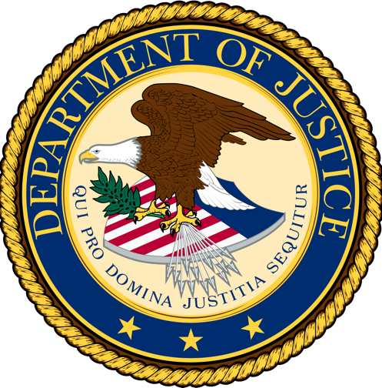
Potomac River Partners : 2025 Year-in-Review
DOJ announces largest healthcare fraud takedown to date
INDIVIDUAL RESPONSIBILITY

Slide 38



INDIVIDUAL RESPONSIBILITY
DOJ’s largest healthcare fraud takedown to date
Allegations total:
$14.6+ billion in fraudulent claims
324 defendants (96 HCPs)
50 federal districts
Fraud covered — DME providers, wound care, opioid trafficking, telemedicine, and genetic testing
Notes:
https://www.justice.gov/opa/pr/national-health-care-fraud-takedown-results-324-defendants-charged-connection-over-146

Slide 39


INDIVIDUAL RESPONSIBILITY
Alexandra Gehrke & Jeffrey King
Pleaded guilty in wound-care wire fraud scheme
Collectively ordered to pay $1.6 billion in restitution and forfeiture
Gehrke sentenced to 15.5 years in prison; King sentenced to 14 years
Notes:
https://www.justice.gov/opa/pr/arizona-couple-pleads-guilty-12b-health-care-fraud
https://www.justice.gov/opa/pr/wound-graft-company-owners-sentenced-12b-health-care-fraud-and-agree-pay-309m-resolve-civil

Slide 40



INDIVIDUAL RESPONSIBILITY
Dr. Kingsley Chin
CEO, SpineFrontier
Pleaded guilty for
false statements to CMS regarding Open Payments
Six months of home confinement
Agreed to pay total fines of >$900K
Notes:
https://www.justice.gov/usao-ma/pr/ceo-spine-device-company-sentenced-false-statements-connection-mandatory-reporting-cms
https://www.ratemds.com/doctor-ratings/890750/Dr-Kingsley+R.-Chin-Wilton+Manors-FL.html/

Slide 41


INDIVIDUAL RESPONSIBILITY
Kevin Ali
CEO, Organon
Resigned after internal investigation into improper financial reporting
Notes:
https://www.reuters.com/business/healthcare-pharmaceuticals/organon-ceo-kevin-ali-resign-after-probe-into-wholesaler-sales-practices-2025-10-27/

Slide 42


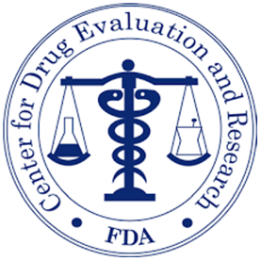
INDIVIDUAL RESPONSIBILITY
George Tidmarsh, PhD
FDA, CDER Director
Resigned after lawsuit by Aurinia Pharmaceuticals investor
Notes:
https://www.reuters.com/legal/litigation/us-fdas-drug-division-chief-resigns-amid-ethics-concerns-lawsuit-2025-11-03/

Slide 43

Potomac River Partners : 2025 Year-in-Review
DOJ announces largest healthcare fraud takedown to date
STATE LAW UPDATES

Slide 44







STATE LAW UPDATES
PBM Oversight
Other State Updates
Alabama mandates PBMs reimburse pharmacies at Medicaid rate
California introduces state branded insulin product via CalRx
Arkansas bans PBMs from owning
or operating pharmacies
California updates PBM licensing
and new disclosures
Massachusetts requires PBMs and manufacturers submit cost data
North Dakota adds new
PBM licensing requirements
Oklahoma bars PBMs/payers
from differential reimbursement
Potomac River Partners : 2025 Year-in-Review
Notes:
https://www.balch.com/insights/publications/2025/09/alabama-new-pbm-law
https://www.whitecase.com/insight-alert/arkansas-bans-pbms-owning-pharmacies-escalating-scrutiny-vertical-integration
https://www.amcp.org/letters-statements-analysis/legislative-update-california-governor-signs-pbm-reform-bill
https://www.afslaw.com/perspectives/health-care-counsel-blog/massachusetts-enacts-drug-pricing-legislation-introducing-pbm
https://www.billtrack50.com/billdetail/1793650
https://www.frierlevitt.com/articles/new-pbm-rules-and-regulations-in-oklahoma/

Slide 45



STATE LAW UPDATES
States Act on Drug Pricing
Other State Updates
California introduces state-branded insulin product
Colorado implements first PDAB* drug price cap on Enbrel
Maryland expands PDAB* authority
New York prohibits payors from charging out-of-pocket for insulin on renewed plans
* PDAB: Prescription Drug Affordability Board
Potomac River Partners : 2025 Year-in-Review
Notes:
https://www.gov.ca.gov/2025/10/16/governor-newsom-announces-affordable-calrx-insulin-11-a-pen-will-soon-be-available-for-purchase/
https://www.advisory.com/daily-briefing/2025/10/13/around-the-nation
https://nashp.org/maryland-passes-nation%C2%92s-first-prescription-drug-affordability-board-legislation/
https://www.nysenate.gov/legislation/bills/2023/S504/amendment/A

Slide 46

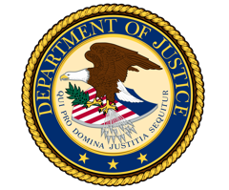

Potomac River Partners : 2025 Year-in-Review
COMPLIANCE NEWS
DOJ and HHS launch FCA Working Group to target healthcare fraud

Slide 47

COMPLIANCE NEWS
Vanda challenges FDA again to share off-label information on Hetlioz for jet lag (April 2025)
DOJ and HHS launch FCA Working Group to target healthcare fraud
Notes:
https://www.justice.gov/opa/pr/doj-hhs-false-claims-act-working-group

Slide 48
COMPLIANCE NEWS
Vanda challenges FDA to share
off-label information on Hetlioz for jet lag (April 2025)
Court orders FDA to act on Vanda NDA application for Hetlioz (August 2025)
FDA rejects application again (January 2026)
Notes:
https://www.biospace.com/fda/vanda-sues-fda-again-this-time-over-off-label-use-of-hetlioz-for-jet-lag
https://www.prnewswire.com/news-releases/in-a-major-win-for-vanda-a-federal-appeals-court-overturns-fdas-order-denying-approval-of-hetlioz-for-the-treatment-of-jet-lag-disorder-302531842.html
https://www.pharmexec.com/view/fda-sends-decision-letter-vanda-pharmaceuticals-nda-hetlioz

Slide 49
COMPLIANCE NEWS
FDA Guidance Updates
Vanda challenges FDA to share
off-label information on Hetlioz for jet lag (April 2025)
Court orders FDA to act on Vanda NDA application for Hetlioz (August 2025)
FDA rejects supplemental NDA (January 2026)
Notes:
https://www.biospace.com/fda/vanda-sues-fda-again-this-time-over-off-label-use-of-hetlioz-for-jet-lag
https://www.prnewswire.com/news-releases/in-a-major-win-for-vanda-a-federal-appeals-court-overturns-fdas-order-denying-approval-of-hetlioz-for-the-treatment-of-jet-lag-disorder-302531842.html
https://www.pharmexec.com/view/fda-sends-decision-letter-vanda-pharmaceuticals-nda-hetlioz

Slide 50


COMPLIANCE NEWS
FDA Guidance Updates
Publishes guidance
on communicating Scientific Information on Unapproved Uses (SIUU)
Notes:
https://www.ropesgray.com/en/insights/alerts/2025/01/fda-finalizes-guidance-on-communication-of-scientific-information
https://www.fda.gov/media/184871/download

Slide 51
COMPLIANCE NEWS
Advisory Updates
FDA Guidance Updates
Finalizes promotional labeling and advertising guidance for biologics/biosimilars
Notes:
https://www.fda.gov/regulatory-information/search-fda-guidance-documents/promotional-labeling-and-advertising-considerations-prescription-biological-reference-products

Slide 52
COMPLIANCE NEWS
Advisory Updates
FDA Guidance Updates
Removes clinical trial diversity guidance
Potomac River Partners : 2025 Year-in-Review
Notes:
https://www.fda.gov/regulatory-information/search-fda-guidance-documents/promotional-labeling-and-advertising-considerations-prescription-biological-reference-products

Slide 53
COMPLIANCE NEWS
FDA Guidance Updates
Takes steps to enhance state importation programs
Rescinds Final Rule on laboratory developed tests
Potomac River Partners : 2025 Year-in-Review
Notes:
https://www.fda.gov/medical-devices/in-vitro-diagnostics/laboratory-developed-tests

Slide 54
COMPLIANCE NEWS
FDA Guidance Updates
Expands pathway for states to import drugs from Canada
Notes:
https://www.fda.gov/news-events/press-announcements/fda-takes-steps-enhance-state-importation-programs-help-lower-prescription-drug-prices

Slide 55
COMPLIANCE NEWS
FDA Guidance Updates
Advisory Updates
Loosens restrictions on real world data used in device submissions
Notes:
https://www.fda.gov/regulatory-information/search-fda-guidance-documents/use-real-world-evidence-support-regulatory-decision-making-medical-devices

Slide 56
COMPLIANCE NEWS
Advisory Updates
In the Courts
FDA Guidance Updates
OIG Issues:
Favorable Opinion on drug manufacturer’s genetic testing program
Unfavorable Opinion on manufactured-paid HCP employee screening
Unfavorable Opinion on manufacturer payments for HCP’s billing software
Potomac River Partners : 2025 Year-in-Review
Notes:
https://btlaw.com/en/insights/alerts/2025/hhs-oig-issues-favorable-opinion-on-drug-manufacturers-free-genetic-testing-counseling-for-patients
https://oig.hhs.gov/compliance/advisory-opinions/25-04/
https://oig.hhs.gov/compliance/advisory-opinions/25-08/

Slide 57




COMPLIANCE NEWS
Advisory Updates
‘But-For’ FCA Causation
First Circuit upholds ‘but-for’ causation in FCA cases involving AKS
Massachusetts District Court denies summary judgement motion under ‘but-for’ causation standard
Notes:
https://www.reuters.com/sustainability/boards-policy-regulation/us-judge-rejects-jjs-10-billion-baby-powder-settlement-2025-04-01/
https://www.hoganlovells.com/en/publications/first-circuit-upholds-but-for-causation-standard-for-false-claims-act-cases-premised-on-anti-kickback-statute-violations
https://ecf.dcd.uscourts.gov/cgi-bin/show_public_doc?2024cv2046-31
https://foleyhoag.com/news-and-insights/blogs/white-collar-law-and-investigations/2025/may/federal-district-court-upholds-hhs-advisory-opinion-blocking-fertility-assistance-program/
https://www.lw.com/admin/upload/SiteAttachments/First-Circuit-Reins-In-Broad-Theory-of-Liability-Under-Anti-Kickback-Statute-by-Adopting-But-For-Causation-Standard.pdf
https://masslawyersweekly.com/files/2025/11/02-621-25.pdf
https://assets.alm.com/c8/ef/bcd76c3742a7a0129ff62b943850/gov-uscourts-mad-136368-336-0.pdf

Slide 58

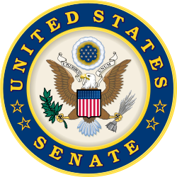
COMPLIANCE NEWS
Additional FDA Updates
Senators reintroduce
bill to expand Sunshine Act to Patient Advocacy Groups
Potomac River Partners : 2025 Year-in-Review
Notes:
https://www.lw.com/en/insights/bipartisan-bill-aims-to-expand-sunshine-act-reporting-for-manufacturers

Slide 59


COMPLIANCE NEWS
Additional FDA Updates
Additional FDA Letters
CMS announces new Medicaid drug pricing model
Potomac River Partners : 2025 Year-in-Review
Notes:
https://www.hoganlovells.com/en/publications/cms-announces-voluntary-generous-medicaid-mostfavorednation-drug-pricing-model-planned-to-launch

Slide 60


Potomac River Partners : 2025 Year-in-Review
INTERNATIONAL COMPLIANCE
China blocks generic drug data amid quality and fraud concerns

Slide 61














INTERNATIONAL COMPLIANCE
International Compliance
COMPLIANCE UPDATES
China blocks generic drug data amid quality and fraud concerns
Australia blocks Cossette acquisition of Mayne Pharma
Turkey fines 17 drugmakers for antitrust violations
Potomac River Partners : 2025 Year-in-Review
Notes:
https://chinadigitaltimes.net/2025/01/chinas-drug-evaluation-center-curtails-public-data-access-amid-generic-medications-scandal-whistleblower-deletes-weibo-account/
https://www.reuters.com/business/healthcare-pharmaceuticals/australia-blocks-cosette-pharmaceuticals-bid-buy-mayne-pharma-2025-11-21/
https://www.pymnts.com/cpi-posts/astrazeneca-pfizer-and-sanovel-among-17-drugmakers-fined-by-turkish-regulator/

Slide 62














International Compliance
COMPLIANCE UPDATES
EU finalizes pharma legislation overhaul
UK, France, and Switzerland launch global corruption task force
China expands unfair competition law’s scope for digital practices
Singapore updates risk classification guidance for Software as Medical Device (SaMD)
Pakistan issues final guidance on biologic product traceability
Potomac River Partners : 2025 Year-in-Review
Notes:
https://www.raps.org/news-and-articles/news-articles/2025/12/eu-legislators-reach-agreement-on-landmark-pharmac
https://www.gov.uk/government/news/uk-france-and-switzerland-announce-new-anti-corruption-alliance
https://www.jdsupra.com/legalnews/china-s-2025-anti-unfair-competition-9805564/#:~:text=The%202025%20revision%20of%20the,with%20the%20new%20legal%20landscape.
https://www.hsa.gov.sg/announcements/regulatory-updates/update-for-guidelines-on-risk-classification-of-samd-and-qualification-of-clinical-decision-support-software-(cdss)
https://www.raps.org/News-and-Articles/News-Articles/2025/7/Asia-Pacific-Roundup-DRAP-publishes-guidance-on-tr

Slide 63



International Compliance
COMPLIANCE UPDATES
ABPI reinstates Novo Nordisk following suspensions
GSK successfully appeals PMCPA ruling
Potomac River Partners : 2025 Year-in-Review
Notes:
https://www.pmcpa.org.uk/cases/completed-cases/case02720824-complainantchief-executive-v-gsk/
https://www.pmcpa.org.uk/cases/completed-cases/auth3760423-complainant-v-gsk/
https://www.abpi.org.uk/media/news/2025/march/novo-nordisk-abpi-membership-restored/

Slide 64

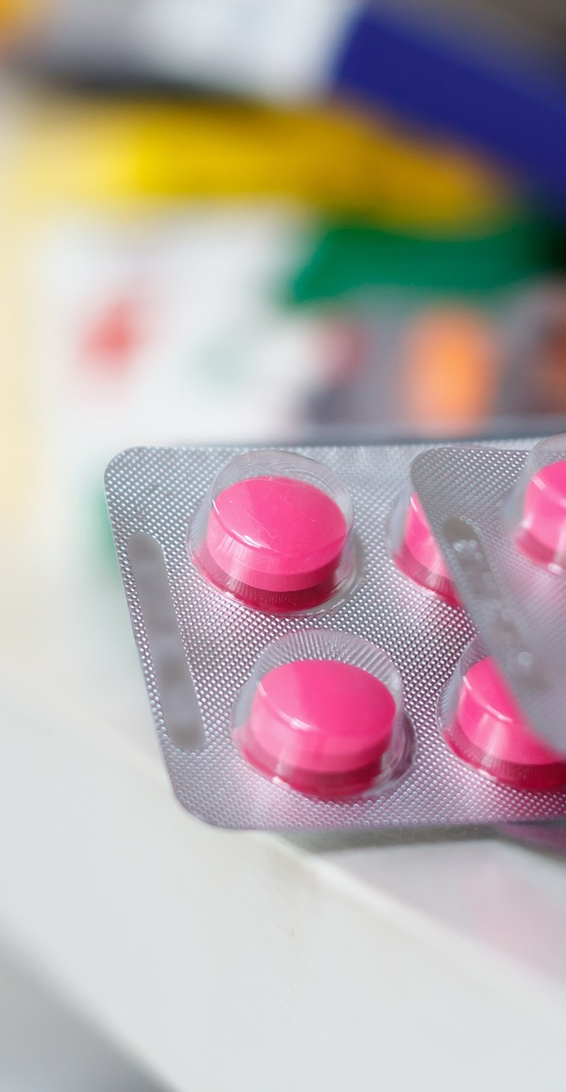



Potomac River Partners : 2025 Year-in-Review
NEW DRUG APPROVALS
FDA approved 58 novel
drugs and biologics…

Slide 65
NEW DRUG APPROVALS
FDA approved 58 novel
drugs and biologics…
Potomac River Partners : 2025 Year-in-Review

Slide 66


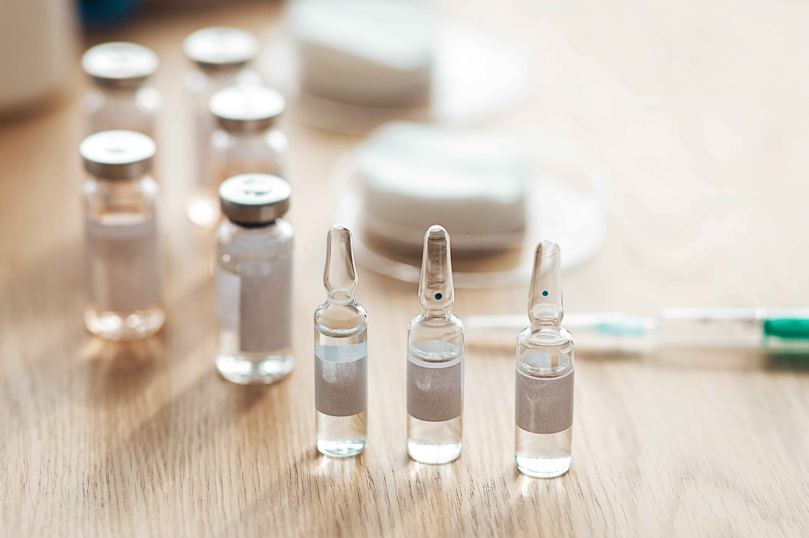




NEW DRUG APPROVALS
20 first-in-class treatments including:
Non-cystic fibrosis bronchiectasis
IGA neuropathy
Moderate to severe pain (non-opioid)
Dry eye disease
Potomac River Partners : 2025 Year-in-Review
Notes:
https://www.fda.gov/drugs/novel-drug-approvals-fda/novel-drug-approvals-2025
https://www.astrazeneca.com/media-centre/press-releases/2025/dato-dxd-approved-in-us-for-hr-p-breast-cancer.html
https://investor.insmed.com/2025-08-12-FDA-Approves-BRINSUPRI-TM-brensocatib-as-the-First-and-Only-Treatment-for-Non-Cystic-Fibrosis-Bronchiectasis,-a-Serious,-Chronic-Lung-Disease
https://www.novartis.com/news/media-releases/novartis-receives-fda-approval-rhapsido-remibrutinib-only-oral-targeted-btki-treatment-chronic-spontaneous-urticaria-csu
https://www.jnj.com/media-center/press-releases/johnson-johnson-receives-fda-approval-for-imaavytm-nipocalimab-aahu-a-new-fcrn-blocker-offering-long-lasting-disease-control-in-the-broadest-population-of-people-living-with-generalized-myasthenia-gravis-gmg
https://ir.cytokinetics.com/press-releases/press-release-details/2025/Cytokinetics-Announces-FDA-Approval-of-MYQORZO-aficamten-for-the-Treatment-of-Adults-with-Symptomatic-Obstructive-Hypertrophic-Cardiomyopathy-to-Improve-Functional-Capacity-and-Symptoms/default.aspx
https://www.gsk.com/en-gb/media/press-releases/exdensur-depemokimab-approved-by-us-fda-for-the-treatment-of-severe-asthma/

Slide 67

NEW DRUG APPROVALS
Plus 23 for rare disease including:
Barth syndrome
Ovarian cancer
Acromegaly
Neurofibromatosis
Idiopathic pulmonary fibrosis
Acute myeloid lymphoma
Nasopharyngeal carcinoma
Midline glioma
Generalized myasthenia gravis
Phenylketonuria
Hereditary angioedema
Thymidine kinase 2 deficiency
Stem cell transplants
Hemophilia
and others
Potomac River Partners : 2025 Year-in-Review
Notes:
https://www.fda.gov/drugs/novel-drug-approvals-fda/novel-drug-approvals-2025
https://www.astrazeneca.com/media-centre/press-releases/2025/dato-dxd-approved-in-us-for-hr-p-breast-cancer.html
https://investor.insmed.com/2025-08-12-FDA-Approves-BRINSUPRI-TM-brensocatib-as-the-First-and-Only-Treatment-for-Non-Cystic-Fibrosis-Bronchiectasis,-a-Serious,-Chronic-Lung-Disease
https://www.novartis.com/news/media-releases/novartis-receives-fda-approval-rhapsido-remibrutinib-only-oral-targeted-btki-treatment-chronic-spontaneous-urticaria-csu
https://www.jnj.com/media-center/press-releases/johnson-johnson-receives-fda-approval-for-imaavytm-nipocalimab-aahu-a-new-fcrn-blocker-offering-long-lasting-disease-control-in-the-broadest-population-of-people-living-with-generalized-myasthenia-gravis-gmg
https://ir.cytokinetics.com/press-releases/press-release-details/2025/Cytokinetics-Announces-FDA-Approval-of-MYQORZO-aficamten-for-the-Treatment-of-Adults-with-Symptomatic-Obstructive-Hypertrophic-Cardiomyopathy-to-Improve-Functional-Capacity-and-Symptoms/default.aspx
https://www.gsk.com/en-gb/media/press-releases/exdensur-depemokimab-approved-by-us-fda-for-the-treatment-of-severe-asthma/

Slide 68

NEW DRUG APPROVALS
Enforcement expands under new theories of FCA liability
What’s next?
Continued emphasis on AI governance, consistency
Telehealth and “digital prescribing” oversight intensifies
Potomac River Partners : 2025 Year-in-Review
Notes:
https://www.dlapiper.com/en/insights/publications/2025/07/relaunch-of-doj-hhs-working-group-reinforces-false-claims-act-enforcement-focus
https://ciberspring.com/articles/fda-is-using-ai-to-police-drug-advertising-across-social-and-digital-channels/
https://www.fda.gov/news-events/press-announcements/fda-launches-crackdown-deceptive-drug-advertising
https://www.pharma-mkting.com/uncategorized/fda-digital-promotion-updates-2025-what-pharma-marketers-must-know/

Slide 69
2025 At a Glance
https://doggett.house.gov/media/in-the-news/wsj-white-house-unveils-trumprx-drug-buying-site-and-pfizer-pricing-deal
https://investor.lilly.com/news-releases/news-release-details/lilly-and-us-government-agree-expand-access-obesity-medicines
https://www.whitehouse.gov/fact-sheets/2025/11/fact-sheet-president-donald-j-trump-announces-major-developments-in-bringing-most-favored-nation-pricing-to-american-patients/
https://www.astrazeneca.com/media-centre/press-releases/2025/astrazeneca-announces-historic-agreement-with-us-government-to-lower-the-cost-of-medicines-for-american-patients.html
https://www.amcp.org/letters-statements-analysis/federal-update-trump-administration-announces-deal-bring-most-favored-nation-pricing-glp-1s
https://www.emdserono.com/us-en/company/news/press-releases/agreement-with-u-s-government-to-expand-access-to-ivf-therapies-16-10-2025.html
https://www.lw.com/en/insights/fda-begins-crackdown-on-direct-to-consumer-pharmaceutical-advertising
https://www.whitehouse.gov/presidential-actions/2025/05/delivering-most-favored-nation-prescription-drug-pricing-to-american-patients/
https://www.taftlaw.com/news-events/law-bulletins/doj-data-security-program-full-enforcement-began-july-8/
Trump Administration
https://www.federalregister.gov/presidential-documents/executive-orders/donald-trump/2025
https://www.whitehouse.gov/fact-sheets/2025/01/fact-sheet-president-donald-j-trump-launches-massive-10-to-1-deregulation-initiative/
https://www.whitehouse.gov/presidential-actions/2025/02/ensuring-accountability-for-all-agencies/
https://www.whitehouse.gov/presidential-actions/2025/02/pausing-foreign-corrupt-practices-act-enforcement-to-further-american-economic-and-national-security/
https://www.whitehouse.gov/fact-sheets/2025/09/fact-sheet-president-donald-j-trump-modifies-the-scope-of-reciprocal-tariffs-and-establishes-procedures-for-implementing-trade-deals/
https://www.fda.gov/drugs/nda-and-bla-approvals/accelerated-approval-program
https://www.fda.gov/drugs/drug-safety-and-availability/fda-announces-new-anda-prioritization-pilot-support-us-generic-drug-manufacturing-and-testing
https://www.whitehouse.gov/presidential-actions/2025/02/making-america-healthy-again-by-empowering-patients-with-clear-accurate-and-actionable-healthcare-pricing-information/
https://www.whitehouse.gov/fact-sheets/2025/12/fact-sheet-president-donald-j-trump-announces-largest-developments-to-date-in-bringing-most-favored-nation-pricing-to-american-patients
DTC Scrutiny
https://www.whitehouse.gov/presidential-actions/2025/09/memorandum-for-the-secretary-of-health-and-human-services-the-commissioner-of-food-and-drugs/
https://www.fda.gov/news-events/press-announcements/fda-launches-crackdown-deceptive-drug-advertising
https://www.fda.gov/drugs/warning-letters-and-notice-violation-letters-pharmaceutical-companies/untitled-letters
https://www.fda.gov/inspections-compliance-enforcement-and-criminal-investigations/compliance-actions-and-activities/warning-letters
https://www.durbin.senate.gov/newsroom/press-releases/durbin-grassley-introduce-bill-to-crack-down-on-prescription-drug-advertisements-boost-price-transparency
Potomac River Partners : 2025 Year-in-Review

Slide 70
DTC Scrutiny
https://www.pmcpa.org.uk/about-us/media/news/pmcpa-press-release-21-july-2025-case-ruled-in-breach-of-clause-2/
https://www.pmcpa.org.uk/cases/completed-cases/case02090624-complainant-v-jazz-pharmaceuticals-uk/
https://schakowsky.house.gov/media/press-releases/schakowsky-taylor-introduce-bill-requiring-price-transparency-prescription
https://www.pmcpa.org.uk/cases/completed-cases/auth38431123-and-auth38441123-complainants-v-novartis/
https://www.pmcpa.org.uk/cases/completed-cases/auth38541123-complainant-v-gsk/
https://www.pmcpa.org.uk/cases/completed-cases/auth3815823-complainant-v-moderna/
https://www.pmcpa.org.uk/cases/completed-cases/auth38571123-complainant-v-astrazeneca/
https://www.pmcpa.org.uk/cases/completed-cases/auth3879224-complainant-v-pfizer/
https://www.pmcpa.org.uk/cases/completed-cases/auth38481123-complainant-v-gilead/
https://www.pmcpa.org.uk/cases/completed-cases/case02840924-voluntary-admission-by-sanofi/
https://pmcpa.org.uk/cases/completed-cases/auth3888424-complainantchief-executive-v-pfizer/
https://www.pmcpa.org.uk/cases/completed-cases/auth38611223-complainant-v-novartis-pharmaceuticals/
https://www.pmcpa.org.uk/cases/completed-cases/auth38691223-complainant-v-eli-lilly/
https://www.pmcpa.org.uk/cases/completed-cases/auth3760423-complainant-v-gsk/
https://www.pmcpa.org.uk/cases/completed-cases/case03871224-complainant-v-astrazeneca/
https://www.pmcpa.org.uk/cases/completed-cases/case02620824-complainant-v-organon/
AI & Digital Health
https://www.fda.gov/news-events/press-announcements/fda-launches-agency-wide-ai-tool-optimize-performance-american-people
https://www.jdsupra.com/legalnews/fda-opens-a-cms-linked-side-door-use-of-7396348/
https://www.advamed.org/industry-updates/news/advamed-leads-with-integrity-updated-code-of-ethics-now-available/
https://artificialintelligenceact.eu/article/16/
https://www.fda.gov/medical-devices/software-medical-device-samd/good-machine-learning-practice-medical-device-development-guiding-principles
https://www.imdrf.org/working-groups/artificial-intelligencemachine-learning-enabled
Federal Settlements
https://www.justice.gov/usao-sdny/pr/us-attorney-announces-202-million-settlement-gilead-sciences-using-speaker-programs
https://www.justice.gov/opa/pr/pfizer-agrees-pay-nearly-60m-resolve-false-claims-allegations-relating-improper-physician
https://www.justice.gov/opa/pr/pharmaceutical-manufacturer-assertio-therapeutics-inc-agrees-pay-36m-resolve-allegations-it
https://www.justice.gov/opa/pr/semler-scientific-inc-and-bard-peripheral-vascular-inc-pay-nearly-37m-resolve-false-claims
Potomac River Partners : 2025 Year-in-Review

Slide 71
Federal Settlements
https://www.cnbc.com/2025/10/07/johnson-johnson-ordered-to-pay-966-million-after-jury-finds-company-liable-in-talc-cancer-case.html
https://www.nbcnews.com/news/us-news/johnson-johnson-owes-655-million-woman-cancer-used-talcum-powder-rcna250209
https://www.justice.gov/usao-md/pr/exactech-agrees-pay-8-million-resolve-false-claims-act-allegations-selling-defective
https://www.justice.gov/opa/pr/aesculap-implant-systems-agrees-pay-385m-resolve-false-claims-act-allegations-related-knee
https://www.justice.gov/opa/pr/wound-graft-company-owners-sentenced-12b-health-care-fraud-and-agree-pay-309m-resolve-civil
https://www.justice.gov/usao-nj/pr/diopsys-inc-agrees-pay-1425-million-resolve-alleged-federal-false-claims-act-and-state
https://www.justice.gov/opa/pr/illumina-inc-pay-98m-resolve-false-claims-act-allegations-arising-cybersecurity
https://www.justice.gov/archives/opa/pr/athira-pharma-inc-agrees-pay-4m-settle-false-claims-act-allegations-related-scientific
FCA Litigation
https://www.cnbc.com/2025/03/28/jj-janssen-false-claims-hiv-drug-marketing-case-.html?msockid=1b11417fc53c65372d7055eac4fb64a5
https://www.reuters.com/legal/government/judge-orders-cvs-omnicare-unit-pay-949-million-over-invalid-prescriptions-2025-07-08/
https://www.reuters.com/legal/government/cvs-unit-must-pay-290-million-drug-whistleblower-lawsuit-judge-rules-2025-08-20/
Civil Litigation
State and Local News
https://www.reuters.com/business/healthcare-pharmaceuticals/jazz-pharma-pay-145-million-settle-narcolepsy-drug-antitrust-case-2025-04-08/
https://www.reuters.com/legal/government/teva-agrees-pay-35-million-settle-asthma-inhaler-antitrust-lawsuit-2025-10-27/
https://www.medtechdive.com/news/biosense-webster-antitrust-lawsuit-reprocessed-catheters/748585/
https://sunpharma.com/wp-content/uploads/2025/07/SEIntimationsettlement.pdf
https://investor.regeneron.com/news-releases/news-release-details/regeneron-prevails-over-amgen-antitrust-pcsk9-lawsuit-protecting
https://healthexec.com/topics/healthcare-management/legal-news/court-approves-28b-bcbs-class-action-settlement-insurer-make-changes
https://www.wmar2news.com/news/region/baltimore-city/baltimore-jury-orders-johnson-johnson-to-pay-woman-1-5-billion-over-alleged-powder-related-cancer-diagnosis
https://www.texasattorneygeneral.gov/news/releases/attorney-general-paxton-secures-415-million-pfizer-and-tris-pharma-providing-adulterated-drugs
https://www.texasattorneygeneral.gov/sites/default/files/images/press/Lilly%20Marshall%20Petition%20Filed.pdf
https://www.jdsupra.com/legalnews/maine-ag-secures-insulin-price-cap-3549524/
https://firstwordpharma.com/story/6644728
https://www.scag.gov/about-the-office/news/attorney-general-alan-wilson-announces-720-million-settlement-with-eight-opioid-drug-makers/
https://www.attorneygeneral.gov/taking-action/ag-sunday-announces-settlement-that-holds-8-opioid-manufacturers-accountable-brings-millions-to-pa-for-prevention-and-treatment/
https://virginiamercury.com/2025/07/10/virginia-lands-16-4m-from-new-opioid-settlement-with-drugmakers/
Potomac River Partners : 2025 Year-in-Review

Slide 72
State and Local News
https://www.reuters.com/legal/litigation/us-fdas-drug-division-chief-resigns-amid-ethics-concerns-lawsuit-2025-11-03/
https://investor.viatris.com/news-releases/news-release-details/viatris-statement-nationwide-settlement-resolve-opioid-related
https://www.hikma.com/news/hikma-announces-agreement-in-principle-for-nationwide-us-opioid-settlement-framework/
https://www.colonialheightsva.gov/AgendaCenter/ViewFile/Item/7986?fileID=12126
https://ag.ny.gov/press-release/2024/attorney-general-james-secures-over-270-million-multistate-settlement-principle
https://rhodeislandcurrent.com/briefs/r-i-s-share-of-latest-national-opioid-settlement-with-drug-manufacturers-is-3m/
https://www.reuters.com/sustainability/boards-policy-regulation/us-judge-rejects-jjs-10-billion-baby-powder-settlement-2025-04-01/
State Law Updates
https://www.balch.com/insights/publications/2025/09/alabama-new-pbm-law
https://www.whitecase.com/insight-alert/arkansas-bans-pbms-owning-pharmacies-escalating-scrutiny-vertical-integration
https://www.amcp.org/letters-statements-analysis/legislative-update-california-governor-signs-pbm-reform-bill
https://www.afslaw.com/perspectives/health-care-counsel-blog/massachusetts-enacts-drug-pricing-legislation-introducing-pbm
https://www.billtrack50.com/billdetail/1793650
https://www.frierlevitt.com/articles/new-pbm-rules-and-regulations-in-oklahoma/
https://www.gov.ca.gov/2025/10/16/governor-newsom-announces-affordable-calrx-insulin-11-a-pen-will-soon-be-available-for-purchase/
https://www.advisory.com/daily-briefing/2025/10/13/around-the-nation
https://nashp.org/maryland-passes-nation%C2%92s-first-prescription-drug-affordability-board-legislation/
https://www.nysenate.gov/legislation/bills/2023/S504/amendment/A
Individual Responsibility
https://www.justice.gov/opa/pr/national-health-care-fraud-takedown-results-324-defendants-charged-connection-over-146
https://www.justice.gov/opa/pr/arizona-couple-pleads-guilty-12b-health-care-fraud
https://www.justice.gov/opa/pr/wound-graft-company-owners-sentenced-12b-health-care-fraud-and-agree-pay-309m-resolve-civil
https://www.justice.gov/opa/pr/texas-doctor-who-falsely-diagnosed-patients-sentenced-10-years-imprisonment-118m-health-care
https://www.justice.gov/usao-ma/pr/ceo-spine-device-company-sentenced-false-statements-connection-mandatory-reporting-cms
https://www.ratemds.com/doctor-ratings/890750/Dr-Kingsley+R.-Chin-Wilton+Manors-FL.html/
https://www.reuters.com/business/healthcare-pharmaceuticals/organon-ceo-kevin-ali-resign-after-probe-into-wholesaler-sales-practices-2025-10-27/
Compliance News
https://www.justice.gov/opa/pr/doj-hhs-false-claims-act-working-group
https://www.biospace.com/fda/vanda-sues-fda-again-this-time-over-off-label-use-of-hetlioz-for-jet-lag
https://www.prnewswire.com/news-releases/in-a-major-win-for-vanda-a-federal-appeals-court-overturns-fdas-order-denying-approval-of-hetlioz-for-the-treatment-of-jet-lag-disorder-302531842.html
Potomac River Partners : 2025 Year-in-Review

Slide 73
Compliance News
International Compliance
https://www.pharmexec.com/view/fda-sends-decision-letter-vanda-pharmaceuticals-nda-hetlioz
https://www.ropesgray.com/en/insights/alerts/2025/01/fda-finalizes-guidance-on-communication-of-scientific-information
https://www.fda.gov/media/184871/download
https://www.fda.gov/regulatory-information/search-fda-guidance-documents/promotional-labeling-and-advertising-considerations-prescription-biological-reference-products
https://www.fda.gov/regulatory-information/search-fda-guidance-documents/promotional-labeling-and-advertising-considerations-prescription-biological-reference-products
https://www.fda.gov/medical-devices/in-vitro-diagnostics/laboratory-developed-tests
https://www.fda.gov/news-events/press-announcements/fda-takes-steps-enhance-state-importation-programs-help-lower-prescription-drug-prices
https://www.fda.gov/regulatory-information/search-fda-guidance-documents/use-real-world-evidence-support-regulatory-decision-making-medical-devices
https://btlaw.com/en/insights/alerts/2025/hhs-oig-issues-favorable-opinion-on-drug-manufacturers-free-genetic-testing-counseling-for-patients
https://oig.hhs.gov/compliance/advisory-opinions/25-04/
https://oig.hhs.gov/compliance/advisory-opinions/25-08/
https://www.hoganlovells.com/en/publications/first-circuit-upholds-but-for-causation-standard-for-false-claims-act-cases-premised-on-anti-kickback-statute-violations
https://www.afslaw.com/perspectives/investigations-blog/medtronic-fca-claims-survive-reconsideration-despite-first
https://www.lw.com/en/insights/bipartisan-bill-aims-to-expand-sunshine-act-reporting-for-manufacturers
https://www.hoganlovells.com/en/publications/cms-announces-voluntary-generous-medicaid-mostfavorednation-drug-pricing-model-planned-to-launch
https://www.justice.gov/opa/pr/doj-hhs-false-claims-act-working-group
https://chinadigitaltimes.net/2025/01/chinas-drug-evaluation-center-curtails-public-data-access-amid-generic-medications-scandal-whistleblower-deletes-weibo-account/
https://www.reuters.com/business/healthcare-pharmaceuticals/australia-blocks-cosette-pharmaceuticals-bid-buy-mayne-pharma-2025-11-21/
https://www.pymnts.com/cpi-posts/astrazeneca-pfizer-and-sanovel-among-17-drugmakers-fined-by-turkish-regulator/
https://www.raps.org/news-and-articles/news-articles/2025/12/eu-legislators-reach-agreement-on-landmark-pharmac
https://www.gov.uk/government/news/uk-france-and-switzerland-announce-new-anti-corruption-alliance
https://www.jdsupra.com/legalnews/china-s-2025-anti-unfair-competition-9805564/
https://www.hsa.gov.sg/announcements/regulatory-updates/update-for-guidelines-on-risk-classification-of-samd-and-qualification-of-clinical-decision-support-software-(cdss)
https://www.raps.org/News-and-Articles/News-Articles/2025/7/Asia-Pacific-Roundup-DRAP-publishes-guidance-on-tr
https://www.pmcpa.org.uk/cases/completed-cases/case02720824-complainantchief-executive-v-gsk/
https://www.pmcpa.org.uk/cases/completed-cases/auth3760423-complainant-v-gsk/
https://www.abpi.org.uk/media/news/2025/march/novo-nordisk-abpi-membership-restored/
Potomac River Partners : 2025 Year-in-Review

Slide 74
New Drug Approvals
What’s Next?
https://www.fiercepharma.com/pharma/2025-drug-approvals
https://www.fda.gov/drugs/novel-drug-approvals-fda/novel-drug-approvals-2025
https://www.fda.gov/vaccines-blood-biologics/development-approval-process-cber/2025-biological-approvals
https://www.astrazeneca.com/media-centre/press-releases/2025/dato-dxd-approved-in-us-for-hr-p-breast-cancer.html
https://investor.insmed.com/2025-08-12-FDA-Approves-BRINSUPRI-TM-brensocatib-as-the-First-and-Only-Treatment-for-Non-Cystic-Fibrosis-Bronchiectasis,-a-Serious,-Chronic-Lung-Disease
https://www.novartis.com/news/media-releases/novartis-receives-fda-approval-rhapsido-remibrutinib-only-oral-targeted-btki-treatment-chronic-spontaneous-urticaria-csu
https://www.jnj.com/media-center/press-releases/johnson-johnson-receives-fda-approval-for-imaavytm-nipocalimab-aahu-a-new-fcrn-blocker-offering-long-lasting-disease-control-in-the-broadest-population-of-people-living-with-generalized-myasthenia-gravis-gmg
https://ir.cytokinetics.com/press-releases/press-release-details/2025/Cytokinetics-Announces-FDA-Approval-of-MYQORZO-aficamten-for-the-Treatment-of-Adults-with-Symptomatic-Obstructive-Hypertrophic-Cardiomyopathy-to-Improve-Functional-Capacity-and-Symptoms/default.aspx
https://www.gsk.com/en-gb/media/press-releases/exdensur-depemokimab-approved-by-us-fda-for-the-treatment-of-severe-asthma/
https://www.dlapiper.com/en/insights/publications/2025/07/relaunch-of-doj-hhs-working-group-reinforces-false-claims-act-enforcement-focus
https://ciberspring.com/articles/fda-is-using-ai-to-police-drug-advertising-across-social-and-digital-channels/
https://www.fda.gov/news-events/press-announcements/fda-launches-crackdown-deceptive-drug-advertising
https://www.pharma-mkting.com/uncategorized/fda-digital-promotion-updates-2025-what-pharma-marketers-must-know/
Music Credits
Serious Corporate by AudioCoffee (CC BY-NC-ND)
Aspiration by BoDleasons (CC BY-NC-ND)
The Serious Business by TimTaj (CC BY-NC-ND)
Corporate by Lite Saturation (CC BY-NC-ND)
Potomac River Partners : 2025 Year-in-Review

Slide 75


Join thought leaders from Potomac and Hogan Lovells
on Tuesday, February 24, at 2pm EST, for a Year-in-Review webinar that dives into the events that shaped this past year. Gain deeper insights to better prepare for 2026!
RSVP to the event by scanning the QR code or
using this link.
We look forward to seeing you!
FOR MORE INFORMATION OR TO RECEIVE THE
2026 YEAR-IN-REVIEW:
ContactUs@potomacriverpartners.com
www.PotomacRiverPartners.com

